Slide 1
Chinese Guideline of Diagnosis and treatment of COVID-19
(7th Version)
Bin Cao, MD
China-Japan Friendship Hospital
Institute of Respiratory Medicine, Chinese Academy of Medical Science
National Clinical Research Center for Respiratory Diseases
Caobin_ben@163.com
18, March 2020

Slide 2
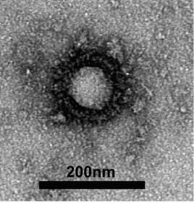
Severe Acute Respiratory Syndrome Coronavirus-2
Belong to the β genus; Have envelopes; Round or oval; diameter being 60 to 140 nm
showed 79.0% nucleotide identity with the sequence of SARS-CoV and 51.8% identity with the sequence of MERS-CoV.
Sensitive to ultraviolet and heat. 75% ethanol, chlorine-containing disinfectant, peracetic acid, and chloroform can effectively inactivate the virus.
Chlorhexidine was not effective

Slide 3
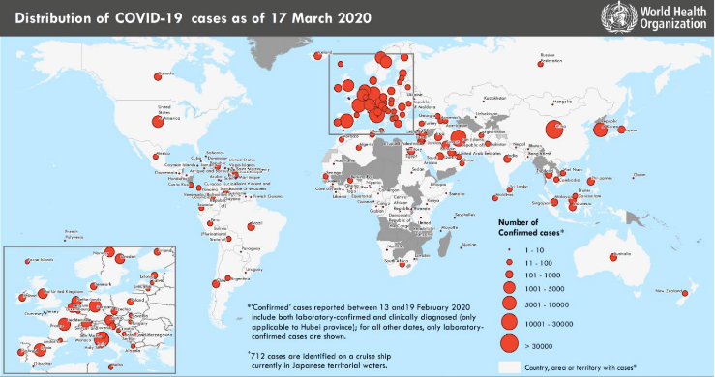
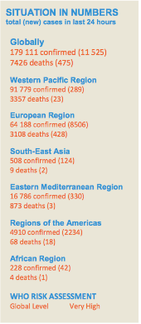
Epidemiology of COVID-19 globally
COVID-19 has spread to the world rapidly. —— A threat of the word
https://www.who.int/docs/default-source/coronaviruse/situation-reports/20200317-sitrep-57-covid-19.pdf?sfvrsn=a26922f2_4

Slide 4
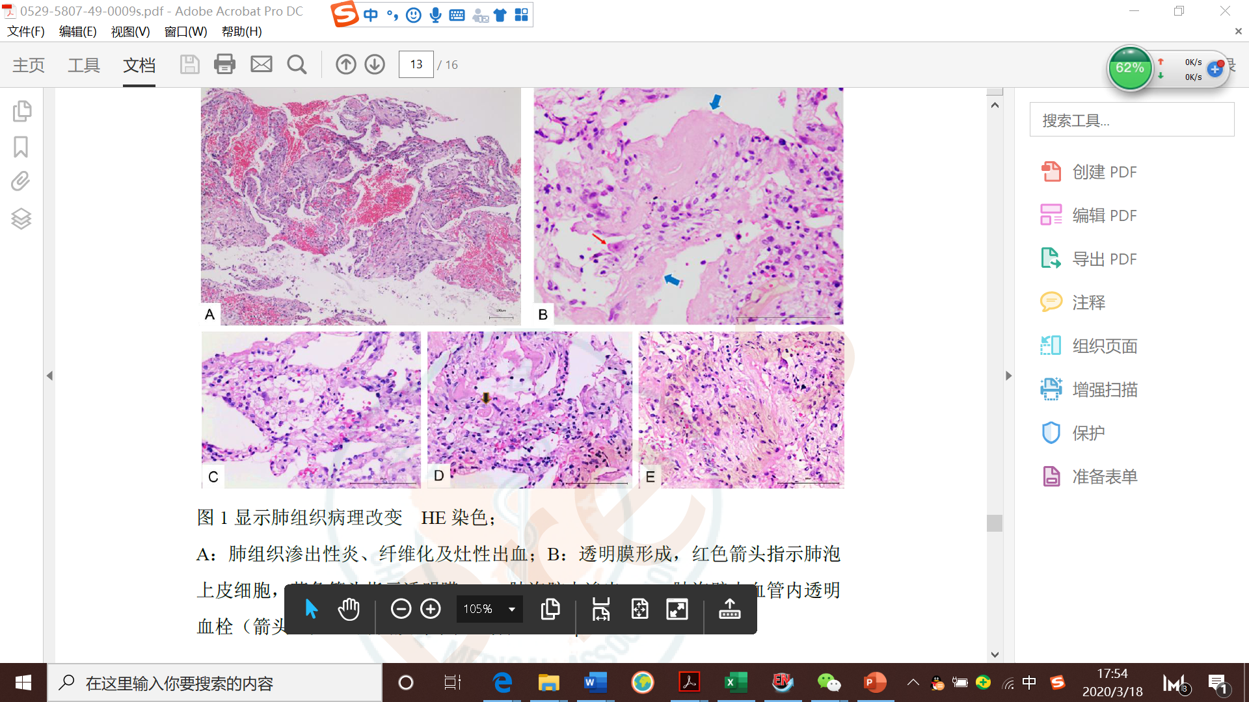
Pathogenic changes of severe COVID-19 in lung
The pathological features in lungs greatly resemble those seen in SARS and MERS infection
bilateral diffuse alveolar damage with cellular fibromyxoid exudates
Hyaline membrane formation（blue arrow)
Interstitial mononuclear
inflammatory infiltrates
Thrombus in pulmonary arterioles (black arrow)
Xiaohong Yao et al. Chinese Journal of Pathology.2020,49 (2020-03-15).
hyaline membrane formation（blue arrow)
Interstitial mononuclear
inflammatory infiltrates
Interstitial mononuclear
inflammatory infiltrates

Slide 5
Severe Acute Respiratory Syndrome Coronavirus-2
Viral particle in Alveolar type II cells (Electron microscopy)
Zhe Xu et al. Lancet Respir Med.2020. DOI: 10.1016/S2213-2600(20)30076-X

Slide 6
Pathogenic changes of severe COVID-19 in other organs
Degeneration and necrosis of parenchymal cells, formation of hyaline thrombus in small vessels, and pathological changes of chronic diseases were observed in other organs and tissues
Decreased numbers of lymphocyte, cell degeneration and necrosis were observed in spleen
Zhe Xu et al. Lancet Respir Med.2020. DOI: 10.1016/S2213-2600(20)30076-X

Slide 7
Diagnostic criteria of COVID-19——Suspected cases
Suspected cases
Epidemiological history (≤14 days) | Clinical symptoms
travel /residence in Wuhan and its surrounding areas,or other communities where COVID-19 has been found | fever and/or respiratory symptoms
contact with COVID-19 patients | imaging characteristics of COVID-19
Contact with patients with fever or respiratory symptoms and from Wuhan and its surrounding areas, or from communities where COVID-19 has been found | Normal or decreased of WBC ;Normal or decreased of Lymphocytes
Clustered cases
Any one criteria of Epidemiological history + Any two Clinical symptoms All three clinical symptoms

Slide 8
Diagnostic criteria of COVID-19——Confirmed cases
Confirmed cases
Etiological or serological evidences
Nucleic acid testing | SARS-CoV-2 RNA was positive detected by real time RT-PCR
 | Viral gene sequence is highly homologous to known new coronaviruses
Serum antibody testing | SARS-CoV-2 specific IgM and IgG are positive in serum
 | SARS-CoV-2 specific IgG is detectable from negative to positive
 | SARS-CoV-2 specific IgG antibody titer shows a 4-fold or higher change between the two sets of serum samples from acute and recovery phase
Suspect cases + one of etiological or serological evidences

Slide 9
IgG/IgM Dynamic changes of Adults with COVID-19
Zhong Liu et al. unpublished data

Slide 10
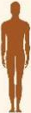
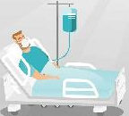
Transmission and incubation of COVID-19
Basic reproductive number R0=2.2-2.95
Median incubation period 4-5.2 days The 95th percentile of the distribution was 12.5 days
COVID-19 patients including the asymptomatic infected people are the main source of infection
Route of transmission
  Respiratory droplets and close contact
  Long-time exposure to the environment with a high concentrations of aerosol
  Environment contaminated by feces/urine → aerosol or contact transmission
All the population are generally susceptible
Y Wang et al. Zhonghua Liu Xing Bing Xue Za Zhi.41 (4), 476-479; Qun Li et al. N Engl J Med. DOI: 10.1056/NEJMoa2001316
Guan WJ et al. N Engl J Med. 2020. doi: 10.1056/NEJMoa2002032

Slide 11
Disease spectrum of COVID-19
81% were mild status
  No pneumonia or mild pneumonia
14% were severe status
  Dyspnea or Respiratory Rate ≥ 30/min or SpO₂ < 93% or PaO₂/FiO₂ <300 mmHg
  Lung infiltrates >50% within 24 to 48 hours
5% were critical ill status
  Needs mechanical ventilation
  Shock
  Complicated with other organ failure required ICU admission
Zunyou Wu et al.JAMA.2020. DOI: 10.1001/jama.2020.2648

Slide 12
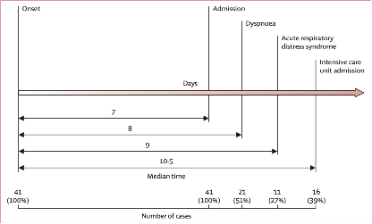
Clinical features of COVID-19 patients
Symptoms and complications | N%
Fever | 98%
Cough | 76%
Myalgia or fatigue | 44%
Sputum production | 28%
Diarrhea | 3%
WBC ≤ 10 × 10⁹/L | 70%
Lymphocytopnia | 63%
ALT > 40 U/L | 37%
Cr > 133 mmol/L | 10%
LDH > 243 U/L | 73%
Hypersensitive troponin I > 28 pg/ml | 12%
Procalcitonin < 0.1 ng/ml | 69%
Acute respiratory distress syndrome | 29%
Symptoms and complications | N%
Acute cardiac injury | 12%
Acute kidney injury | 7%
Septic shock | 7%
Secondary infection | 10%
Huang C et al. Lancet. 2020;395(10223):497-506.

Slide 13
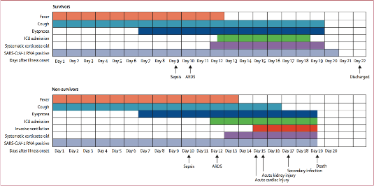
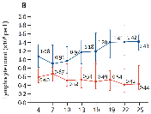
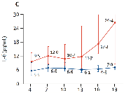
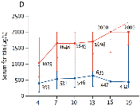
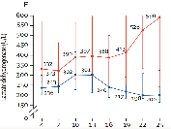
Clinical course of COVID-19——Severe and critical illness
Duration of dyspnea was 13 days in survivors
45% survivors still had cough on discharge
Median duration of viral shedding was 20 days, could prolong as 37 days
lymphocyte count was lowest on day 7 after illness onset and improved during hospitalisation in survivors but whereas severe lymphopenia was observed until death in non-survivors.
Fei Zhou et al. Lancet.2020. DOI: 10.1016/S0140-6736(20)30566-3

Slide 14
Inflammation of COVID-19——Severe and critical illness
IL-1β, IL-6, G-SCF, IP-10, and MCP1 were significantly elevated
Peripheral lymphocyte counts, mainly T cells were substantially reduced in severe COVID-19 patients
Host-directed therapies might be an option
Huang C, et al. Lancet 2020; 395(10223): 497-506; Liu J, et al. BMJ 2020;published online Feb 19.

Slide 15
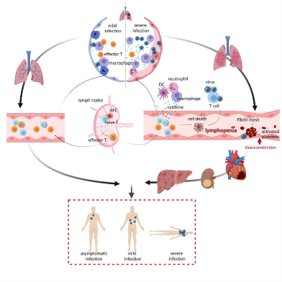
SARS-CoV-2 Viral sepsis——From Bedside to Bench
Multi-organ dysfunction
Pneumonia, Respiratory failure, Acute respiratory distress syndrome
Metabolic acidosis and internal environment disorders
Acute kidney injury
Acute cardiac injury
………
——Viral Sepsis
Ren L, et al. Chin Med J 2020; DOI: 10.1097/CM9.0000000000000722；Huang C, et al. Lancet 2020; 395(10223): 497-506
Hui Li, et al. 2020; unpublished, under revision

Slide 16
Abnormal coagulation is common in severe COVID-19
D-Dimer ＞ 1ug/ml was independent risk factor of in-hospital death
Significantly increased D-dimer and FDP were associated with poor prognosis
Vascular endothelium inflammation Extensive intravascular microthrombosis on autopsy
Vascular endothelial cells express high levels of ACE2
Anticoagulation therapy should be initiated for severe COVID-19 patients if otherwise contraindicated.
Zhou F, et al. Lancet 2020; DOI:10.1016/S0140-6736(20)30566-3; Hamming I, et al. J Pathol 2004; 203(2): 631-7.

Slide 17
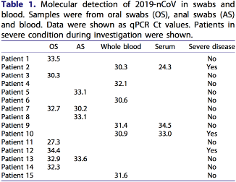
SARS-CoV-2 RNA detection in COVID-19 patients
SARS-CoV-2 RNA could be detected in nasopharyngeal swabs, sputum, lower respiratory tract secretions, blood, feces using RT-PCR and/or NGS methods
Positive rate was higher in lower respiratory tract specimen
The specimens should be submitted for testing as soon as possible after collection
Wei Zhang et al.Emerg Microbes Infect, 9 (1), 386-389; Yang Y et al. medRxiv 2020.

Slide 18
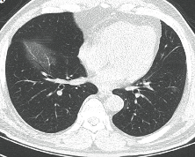
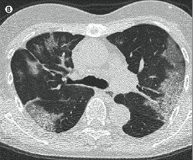
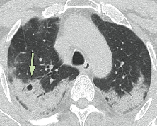
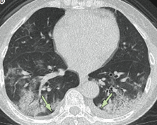
Features of CT scan of COVID-19
56-year-old man
Day 3 after symptom onset
Focal ground-glass opacity
74-year-old woman
Day 10 after illness onset
Bilateral, peripheral ground-glass opacity
61-year-old woman
Day 20 after symptom onset
Bilateral and peripheral predominant consolidation
63-year-old woman
Day 17 after symptom onset
Bilateral, peripheral mixed pattern；Air bronchogram；
Pleural effusion
Common:bilateral lung involvement(79%); peripheral distribution (54%); diffuse distribution (44%)
ground­ glass opacity (65%); without septal thickening(65%).
Less common: nodules (6%), cystic changes (10%), bronchiolectasis (11%), pleural effusion (5%).
Not observed: Tree­ in­ bud signs, masses, cavitation, and calcifications
Heshui Shi et al. Lancet Infect Dis.2020. DOI: 10.1016/S1473-3099(20)30086-4

Slide 19
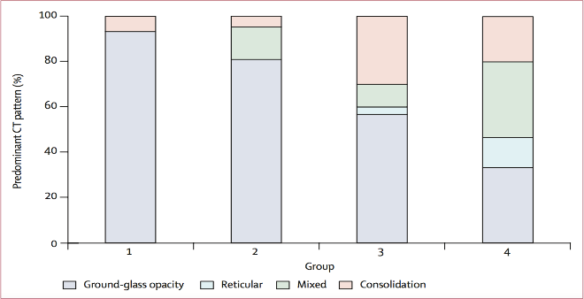
Features of imagine change over time
Ct scan before illness onset
>2 weeks to 3 weeks after symptom onset
≤ 1 week after symptom onset
>1 week to 2 weeks after symptom onset
Heshui Shi et al. Lancet Infect Dis.2020. DOI: 10.1016/S1473-3099(20)30086-4

Slide 20
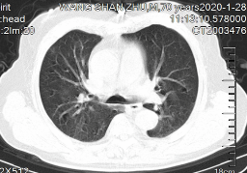
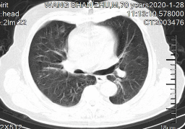
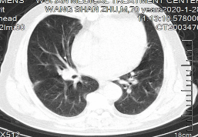
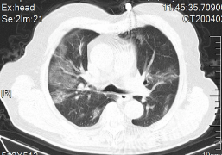
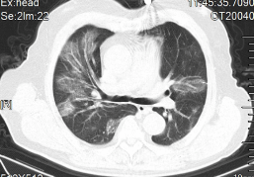
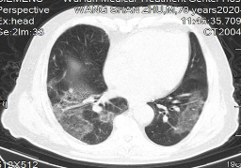
Rapid deterioration on CT scan-case 1
Male, 70 years old
2020-1-28 Day 9 after illness onset
2020-2-1 Day 13 after illness onset. Died 2 weeks later.

Slide 21
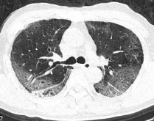
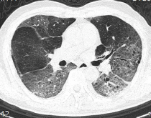
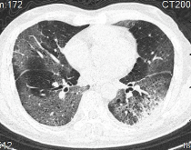
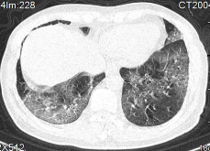
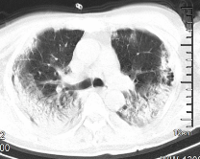
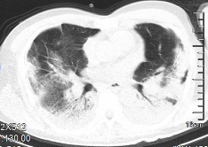
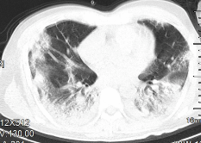
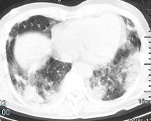
Rapid deterioration on CT scan-case 2
Male, 62 years old
2020-2-7 Day 12 after illness onset
2020-2-7 Day 19 after illness onset. Died 15 days later

Slide 22
Isolation and Support treatment of COVID-19
All confirmed patients should be isolation.
Suspected case should be treated in isolation in a single room
Hospital and ICU admission decision was according to disease severity
Strengthening support treatment (most patients complicated with hypoproteinemia)
  sufficient caloric
  water and electrolyte balance
Oxygen therapy
Closely monitoring vital sign and laboratory (progress rapidly in severe patients)
  WBC; Lymphocyte
  Biochemical indicators (liver enzyme, myocardial enzyme, renal function .etc)
  Marker of inflammation (serum ferritin, IL-6, cytokine)
  Chest imaging
Ren L, et al. Chin Med J 2020; DOI: 10.1097/CM9.0000000000000722
Huang C, et al. Lancet 2020; 395(10223): 497-506.
Ren L, et al. Chin Med J 2020; DOI: 10.1097/CM9.0000000000000722
Huang C, et al. Lancet 2020; 395(10223): 497-506.

Slide 23
Treatment options for severe or critical COVID-19
Respiratory support
Circulatory support
Renal replacement therapy
Convalescent plasma treatment
Immunotherapy
Blood purification treatment
Other therapeutic measures

Slide 24
Antiviral interventions
So far, no specific antiviral against SARS-CoV-2 has been proved
Clinically evaluated drugs：
  Lopinavir/ritonavir monotherapy (LOTUS China, ChiCTR2000029308): completed, manuscript accepted, online tomorrow
    Promising results
  CAP China Remdesivir 1 (mild-moderate pneumonia, NCT04252664): ongoing
  CAP China Remdesivir 2 (severe-critical pneumonia, NCT04257656): ongoing
Emmie de Wit et al. Nature Reviews Microbiology 2016; 14, 523–534
Timothy P Sheahan; Nat Commun 2020; 11 (1), 222
Yeming wang, et al. Trial, 2020, under peer review

Slide 25
CAP-China Remdesivir trials on going for COVID-19
Remdesivir：
First dosage：200mg iv qd×1days；
Continuous 100mg qd×9days
Placebo：50ml qd×10days
2:1
randomization
Standard care + Remdesivir
Standard care + Placebo
Total course of treatment: 10 days
≤ 12 days
Screen
enroll
Follow up
Illness
onset
hospitalization
24 h
Day 0
Day 1
Day 3
Day 5
Day 7
Day 10
Day 14
Day 21
Day 28
Primary outcome：Clinical improvement on day 28
Secondary outcome：The time from randomization to clinical improvement
The clinical trail of Remdesivir treatment for severe COVID-19 is on going

Slide 26
Antiviral for COVID-19: other potential choices
Alpha-interferon: 5 MU, atomization inhalation twice daily
Ribavirin: used together with interferon or lopinavir/ritonavir, 500 mg twice or three times of intravenous injection daily, no longer than 10 days
Chloroquine phosphate: 500 mg bid for 7 days for adults aged 18-65 with body weight over 50 kg; 500 mg bid for Days 1&2, and 500 mg daily for Days 3-7 for adults with body weight below 50 kg
Arbidol: 200 mg three time daily for adults, no longer than 10 days
Convalescent plasma treatment: infusion dose 200-500ml (4-5 ml/kg)×2
Favipiravir

Slide 27
Use of corticosteroid is still controversial
Only for patients with rapid progressive deterioration oxygenation, radiology imaging and excessive inflammation
Contraindications: allergy; un-controlled diabetes; uncontrolled hypertension; glaucoma; GI bleeding; immunodepression; lymphocyte less than 300/ul; severe bacterial and/or fungal infections
Short term, 3-5 days
Low-moderate dosage
  no more than methylprednisolone 1-2 mg/kg/day
Lianghan Shang et al. Lancet.2020. https://doi.org/10.1016/PII
Zhao JP, et al. Zhonghua Jie He He Hu Xi Za Zhi 2020; 43: E007 (in Chinese).

Slide 28
Dilemma of ARB/ACEi
Letter from Prof. Giovanni de Simone, Chair, Council on Hypertension, European Society of Cardiology
  Anti-RAS meds of course reduce angio-II activity, which is good for lung inflammatory response.
  However, too much inhibition of angio-II might increase ACE2 activity, because angio-II increase ACE2 cleavage through AT1R-activated TNF-alfa-ACE, and this might not be good for the COVID-19 action.
Bin Cao’ response to Prof. Giovanni de Simone
  In our cohort, 48% (26/48) non-survivors had hypertension, whereas the percentage of hypertension was only 23% (32/137) in survivors. The OR for hypertension in ANOVA is 3.05 (1.57-5.92).
  No definite answer to the question of ARB/ACEi
Zhou F, et al. Lancet 2020; DOI:10.1016/S0140-6736(20)30566-3

Slide 29
Discharge criteria of COVID-19
Body temperature is back to normal for more than three days
Respiratory symptoms improved obviously
Pulmonary imaging shows obvious absorption
Two consecutive negative nucleic acid tests for respiratory specimens (sampling interval being at least 24 hours)

Slide 30



Acknowledgements
China-Japan Friendship Hospital
Chen Wang; Yeming Wang; Fei Zhou; Guohui Fan; Hui Li; Zhibo Liu; Yi Zhang
University of Virginia
Frederick G Hayden
Oxford University
Peter W Horby
HuaZhong University
Liang Liu
Cooperators:
Wuhan Jinyintan Hospital | Wuhan Tongji Hospital
Wuhan Lung Hospital | The Central Hospital of Wuhan
Zhongnan Hospital of Wuhan University | Renmin Hospital of Wuhan University
Union Hospital | Wuhan First hospital
Wuhan Third hospital | Wuhan Fourth hospital
All health-care workers involved in the diagnosis and treatment of patients in Wuhan

