Slide 1
Epidemic Cerebrospinal Meningitis(ECM)
Yun ZHU
Infectious diseases Teaching and research group
NanFang Hospital

Slide 2
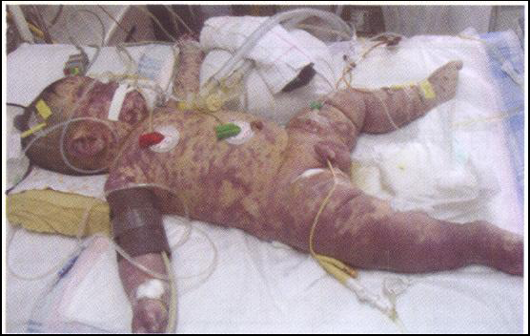
January 8 ，
A baby, male, 18 days,
jaundice for 15 days, accompanied by fever
, poor response for 3h,
the family had a cold;
petechiae in the trunk 4 hours after admission
WBC 3.1×10⁹/L, PLT 23×10⁹/L，PT 120s

Slide 3
epidemic cerebrospinal meningitis

Slide 4
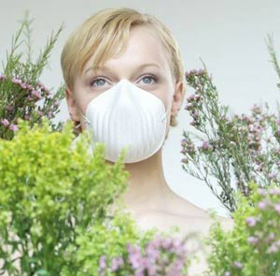
Can you answer these questions？
What is the epidemic cerebrospinal meningitis？
How do people get the epidemic cerebrospinal meningitis ？
Who are easy to get the epidemic cerebrospinal meningitis ？
How to prevent the epidemic cerebrospinal meningitis？

Slide 5
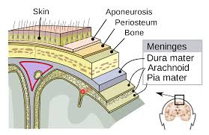
Meninges

Slide 6
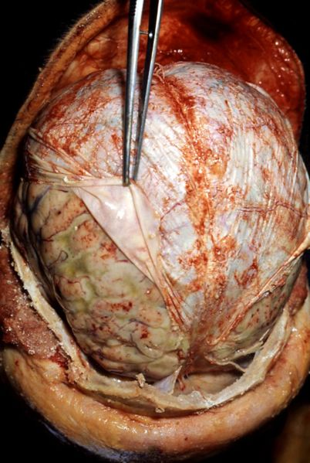
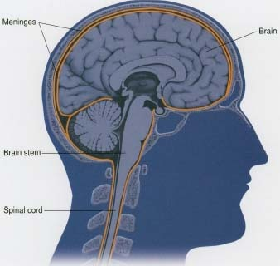
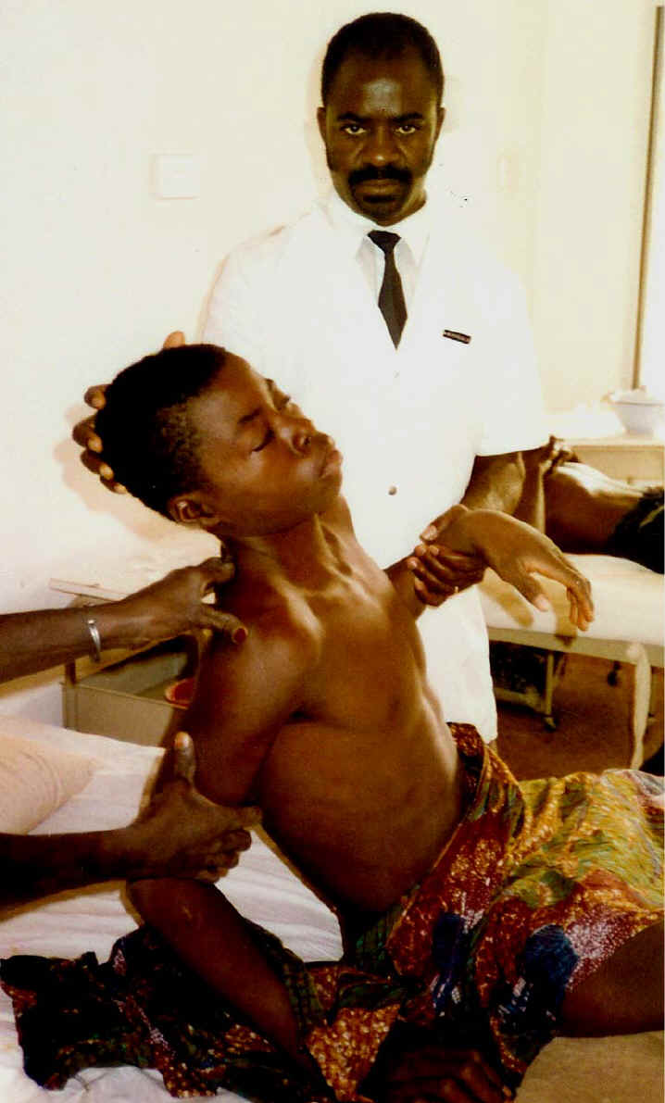
Bacterial Meningitis：infectious disease characterized by inflammation of the meninges (the tissues that surround the brain or spinal cord) caused by a bacterial infection; symptoms include headache, stiff neck, fever and nausea

Slide 7
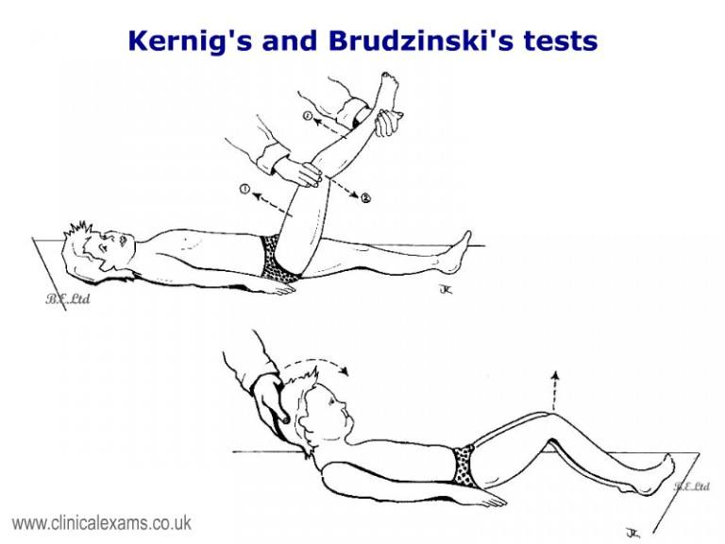
Meningitis Signs：
Nuchal rigidity: Passive or active flexion of the neck result in an inability to touch the chin to the chest.
Brudzinski sign: Spontaneous flexion of the hips during attempted passive flexion of the neck.
Kernig sign: Inability to allow full extension of the knee when the hip is flexed 90 degrees.

Slide 8
1
Introduction
2
Etiology
3
3
Epidemiology
Pathogenesis
4
5
Clinical Manifestations
6
Prophylaxis

Slide 9
Overview
Pathogen： Menigococus
Clinical manifestations ： fever, headache, vomiting, neck stiffness （meningeal irritability） and ecchymosis
Seasonality：
More common in winter and spring
Susceptible population：children

Slide 10
Overview
Meningococus is the leading cause of bacterial meningitis in children and young adults.
The 2nd most common cause of community-acquired adult bacterial meningitis.

Slide 11
Overview
1805 first described by Vessieux, Switzerland
A small epidemic in Geneva
1811 spotted fever
1887, German scholar Weichselbaum discovered “Neisseria meningitidis”
1890， scholar recognized that the organism could be carried in the nasopharynx of healthy individuals.
1909 serotypes of meningococus were identified
1939,it was treated by sulfonamides
1963, the first report of resistance to sulfonamides （California，United States）

Slide 12
Overview
In 1896, it was official reported in Wuchang
There have been five national epidemic outbreaks in Chinese history.
1938
1948
1959
1967
1977

Slide 13
History
Meningococcal epidemics among military recruits were a major consequence of military mobilization.
The military participated in a number of important studies dealing with meningococcal disease.
During World War I, the British army recognized that the frequency of carriage of the case strain rose prior to and during epidemics.
During World War II，the United States army used chemoprophylaxis with sulfonamides.
During the Vietnam War, the United States military continued to pursue chemoprophylaxis, which led to the identification of rifampin as effective agents.
The United States army also played a major role in the development of the meningococcal capsular polysaccharide vaccine.

Slide 14
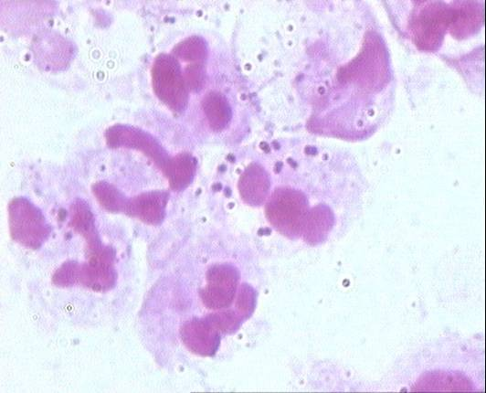
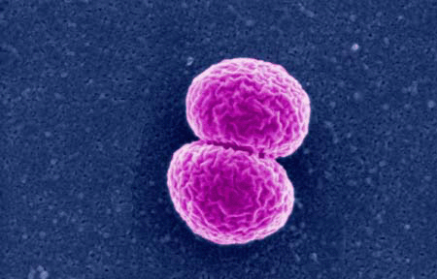
Etiology
Neisseria meningitidis (Meningococcus)
Neisseria strain
Aerobic or facultatively anerobic
Kidney or bean shape
Gram-negative diplococcus

Slide 15
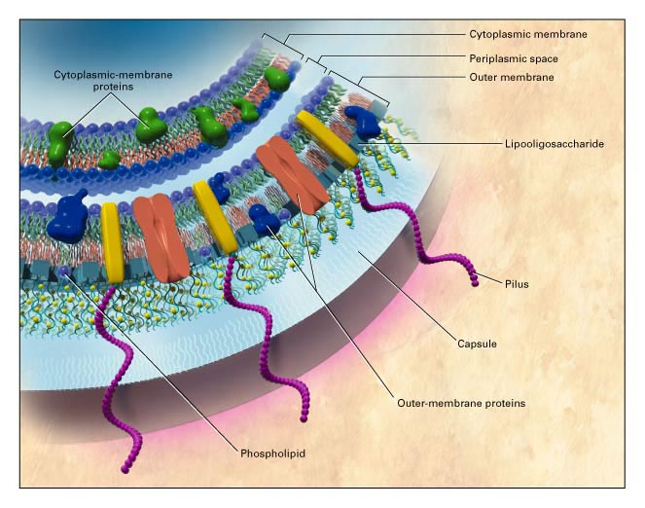
Etiology
内毒素
菌毛
群特异性抗原
Serogroups: A, B, C, X, Y, Z, W135, L
Exclusively infects humans
Easy to produce drug resistance
In vitro ：Highly susceptible
to cold，high PH，drying
High nutritional requirements - chocolate blood agar plate （3%～10%CO2，pH7.4～7.6）

Slide 16
Etiology
N. meningitidis uses a variety of virulence factors to adhere to and invade human epithelial and endothelial cells and to evade the human immune response.
These include phase variation, antigenic variation, and molecular mimicry of human antigens.
Principle Virulence factors
Capsule——Barrier to phagocytosis
LOS（Endotoxin）——Sepsis shock，DIC
Pili - attachment organelles

Slide 17
Etiology
Cell entry
Upon contact with epithelial cells, the meningococcus initiates cytoskeletal changes within the cell-- pili, Opc, and OpaA can trigger these rearrangements.
The bacteria are incorporated into vacuoles and then transported to the basolateral surface of the cell.
Survival within epithelial cells-- the capsule
Interaction with phagocytic cells and the complement system
Biofilm formation by meningococcus

Slide 18
Etiology
LOS is generally present on gram-negative pathogens.
The oligosaccharide portions of LOS contain structures that mimic human tissue antigens.
LOS interacts with a variety of cells including macrophages, neutrophils, and endothelium to initiate the release of inflammatory mediators of the shock state. (TNF necrosis factor-alpha, IL-1 and -6, and interferon-gamma)
The symptoms of meningococcal sepsis are typically caused by LOS acting as an endotoxin and activating proinflammatory cytokine pathways in the host.

Slide 19
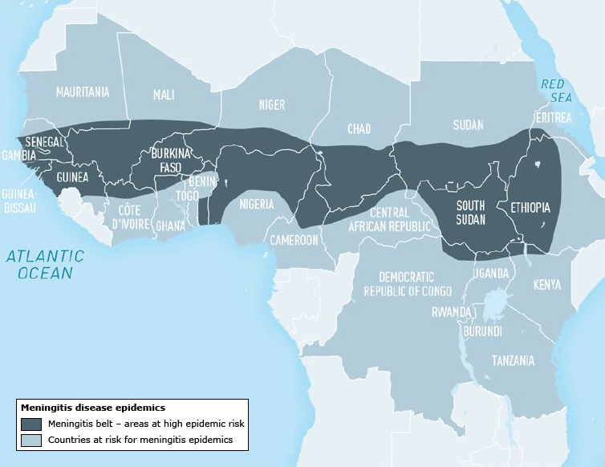
Epidemiology
Endemic infection
Epidemic infection

Slide 20
Epidemiology
The overwhelming majority of disease worldwide is caused by four serogroups:
Serogroup | epidemic areas
A | Africa China
B | Europe America
C | Europe ； North America；China
Y | America since 1990s（kids）
Predominant serogroups in US B, C,
in China A, B，C

Slide 21
Epidemiology
Coughing, sneezing
Patients
Carriers
Susceptible
Especially the kids under 5 y
Close contact
Source of infection: Carriers and patients
Rout of transmission：respiratory transmission，
close contact transmission（＜2y）
Susceptibility: Universal susceptible, tends to strike infants and young children from 6m to 2 years old
Immunity: Stable and persistent immunity
Popular season: obvious seasonality,
most common in winter and spring
Periodicity: Small epidemics occur every 3 to 5 years ,
Pandemics occur every 7 to 10 years 。
Notes:
60%～70%隐性感染，30%上呼吸道感染和出血点型，典型流脑仅占1%。感染后终生免疫。

Slide 22
Pathogenesis
Immunity status
Virulence
Factors

Slide 23
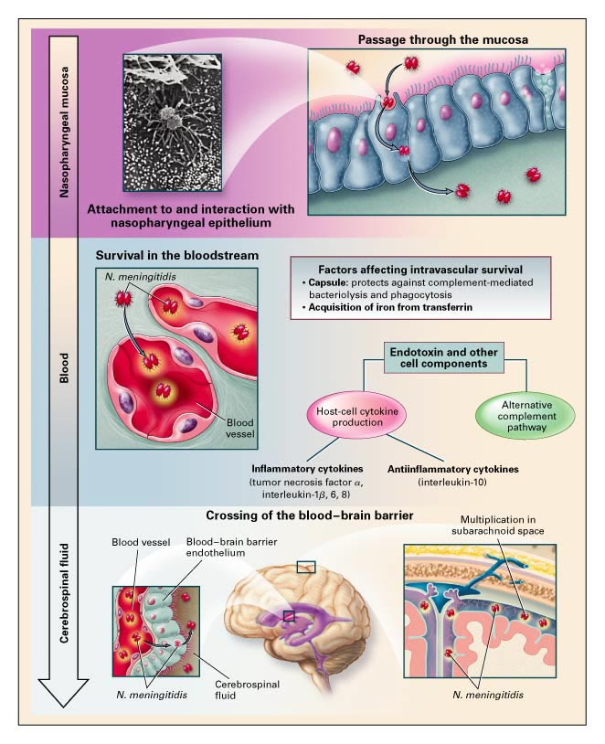
Pathogenesis (Common type)
Upper respiratory tract infection
low fever
sore throat
cough
stuff nose
‘1~2d’
high fever,rigors
headache
Purpura, petechiae,
ecchymosis(70 % ~90%)
shock, DIC
‘1~2d’
Septicemia
ICP
severe headache
agitation,seizure
meni- irritation
mental changes
‘2~5d’
Meningitis
Notes:
The bacteria are incorporate d into vacuoles and then transported to the basolateral surface of the cell.
3. Cross BBBn
Upper respiratory tract infection: local inflammation
Septicemia : Endothelial injury, inflammation, necrosis, thrombosis
Meningitis: purulent inflammation of pia mater & arachnoid
Outbreak meningitis: Congestion, hemorrhage, edema, necrosis of brain parenchyma

Slide 24
Pathogenesis(Fulminant type)
1 Shock
Bacterial Endotoxin
Multiplication
Peripheral Vasoconstriction
Microcirculatory disorder
DIC
Multiple organ failure
Shock
bleeding
2 Meningoencephalitis
Bacterial Multiplication
Endotoxin
Brain Edema
Contraction of brain vessel
Cerebral palsy
Cerebral hernia

Slide 25
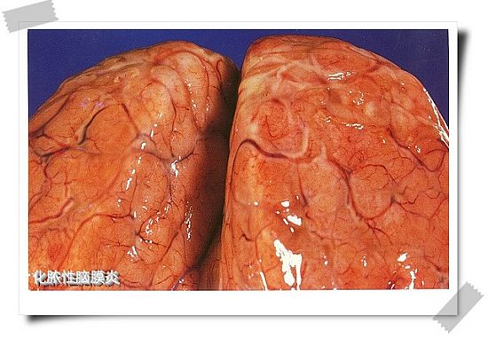
The subarachnoid space is filled with gray-yellow pus

Slide 26
Clinical manifestation
Clinical type
Acute systemic meningococcal disease
Meningitis : 70%
Meningitis with accompanying meningococcemia
Meningococcemia without meningitis : 27%
Chronic Menigococcemia

Slide 27
Clinical manifestation
Clinical type
Common Type 90%
Fulminant Type
Chronic Septic Type

Slide 28
Clinical manifestation
The incubation period is 1 to 10 days, usually 2 to 3 days.
Due to acute onset, rapid progress, it is often difficult to distinguish the clinical stages.
Common Type
Upper respiratory tract infection
Septicemia
Meningitis
Convalescent stage
Notes:
临床表现
单纯型
肺出血型
黄疸出血型
脑膜脑炎型
肾功能衰竭型
后期并发症

Slide 29
Clinical manifestation
Asymptomatic
Or Low fever, cough, sore throat, nasopharyngeal mucosal congestion and increased secretion
Misdiagnosed easily
Nasopharyngeal swab culture (+)
Common Type:
URT infection
Septicemia
Meningitis
Convalescent stage

Slide 30
Clinical manifestation
Symptoms of infection : chills, high fever, headache and vomiting, decreased ability to concentrate
Rash (70%)
Appear as discrete lesions，1-2 mm in diameter,
The petechiae can coalesce into larger purpuric and ecchymotic lesions.
Most frequently on the trunk and lower potions of the body.
Common Type:
URT infection
Septicemia
Meningitis
Convalescent stage

Slide 31
Clinical manifestation
lasting 2-5 days
Fever, infection symptoms
Central nervous system symptoms:
Symptoms of intracranial hypertension : severe headache, frequent vomiting
Meningeal irritation: neck stiffness, Brudzinski sign and Kernig sign positive
Symptoms of cephalitis: convulsions and mental disorders
Common Type:
URT infection
Septicemia
Meningitis
Convalescent stage

Slide 32
Clinical Manifestation
Decreased body temperature;
The ecchymosis disappears or Scar healing
Symptoms of intracranial hypertension, meningeal irritation, signs of brain parenchymal damage relieved
Common Type:
URT infection
Septicemia
Meningitis
Convalescent stage
Notes:
临床表现
单纯型
肺出血型
黄疸出血型
脑膜脑炎型
肾功能衰竭型
后期并发症
赫氏反应
青霉素治疗后加重反应，一般在首剂青霉素2～4（1/4～6）小时发生，突起发冷、寒战、高热，持续0.5～2小时,继后大汗,发热骤退,重者可发生休克,大部分病人可导致病情加重。

Slide 33
Clinical manifestation
Fulminant type:
Septic shock
Meningoencephalitis
Hybrid Type
More common in children.
The acute onset of cutaneous hemorrhage and necrosis.
If not treated in time, patient can die within 24 hours.

Slide 34
Clinical manifestation
Severe toxemia
wildly petechiae, purpura, ecchymosis
Refractory shock : hypotension, pallor, cyanosis, cold extremities
DIC;
MOF;
Meningeal irritation signs is absent,
CSF is normal;
Blood Culture of meningococcus.
Fulminant types:
Septic shock
Meningo-
encephalitis
Hybrid

Slide 35
Clinical manifestation
Fulminant types:
Septic shock
Meningo-
encephalitis
Hybrid
Serious brain parenchymal damage: coma
Cerebral hernia
Respiratory failure
Localized neurological signs

Slide 36
Clinical manifestation
Severe systemic toxemia
Intractable shock, large ecchymoses
Brain parenchymal damage: repeated convulsions, coma, respiratory failure, cerebral palsy
Intracranial hypertension:
Severe headache; projectile vomiting;
Papillar edema; encephalocele;
The worst prognosis
Fulminant types:
Septic shock
Meningo-
encephalitis
Hybrid

Slide 37
Clinical manifestation
Rare, mostly adult
Prolonged course
Characterized by intermittent fever, rash or blemishes, multiple joint pain
Blood culture can be positive
Chronic
Septic type

Slide 38
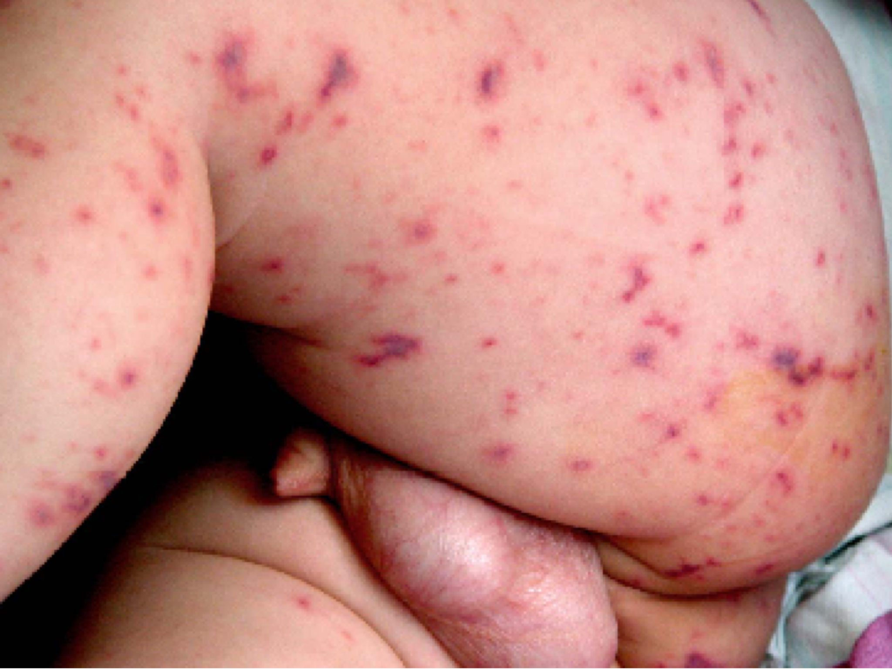
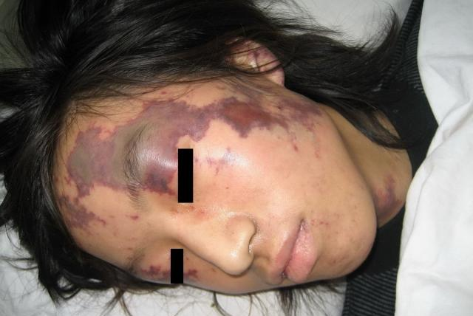

Slide 39
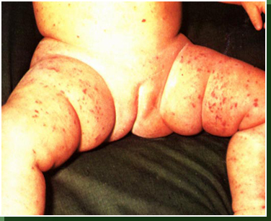
skin ecchymosis

Slide 40
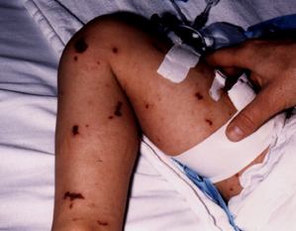

Slide 41
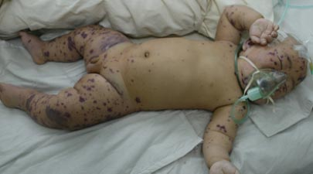
Shock type: widespread ecchymosis
confluent ecchymosis

Slide 42
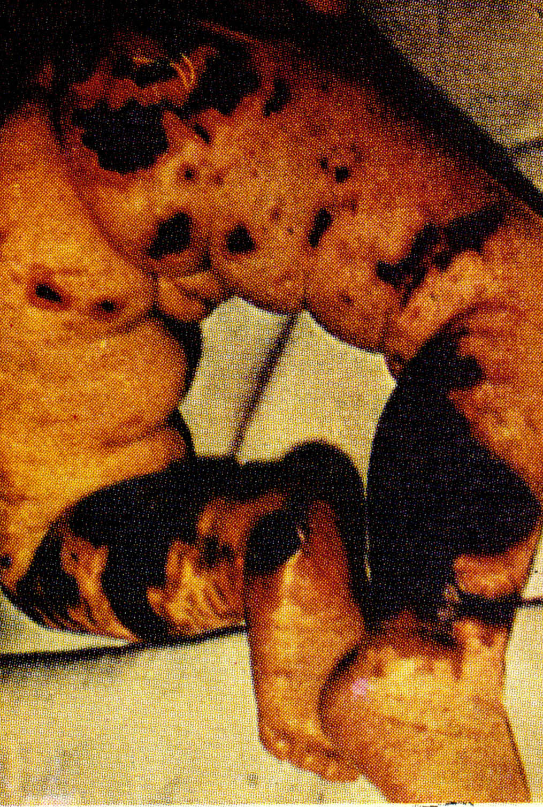
Purpura fulminans:
Cutaneous hemorrhage and necrosis

Slide 43
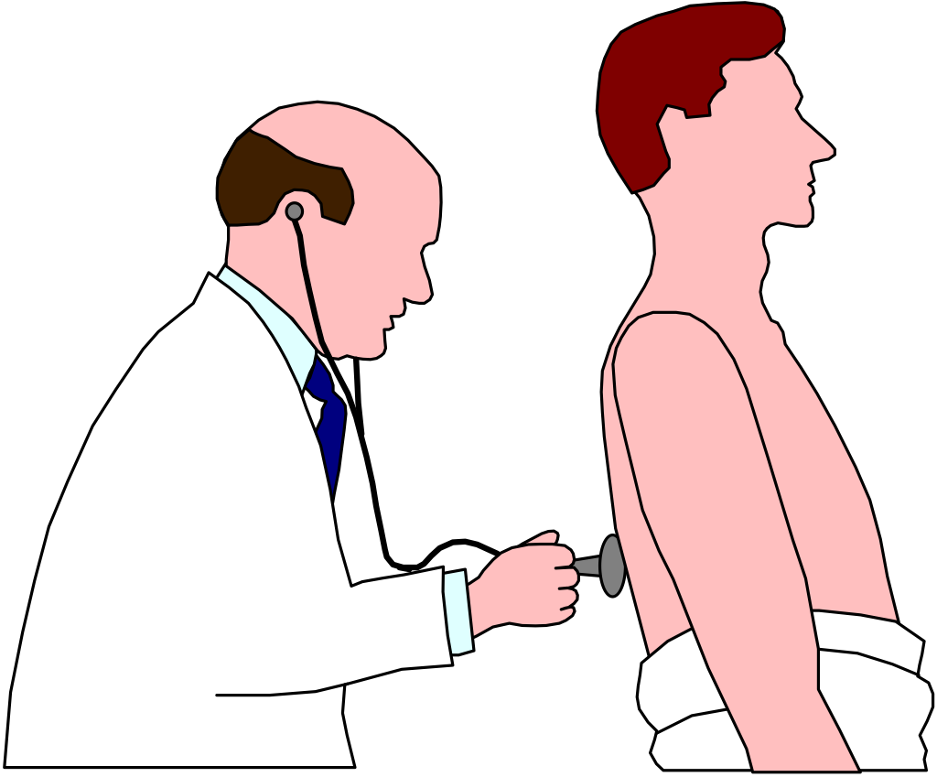
Complications and sequelae
Complications:
Suppurative lesions caused by bacterial dissemination (otitis media, purulent arthritis, endocarditis, etc.)
rare due to timely treatment
Sequelae : Cranial nerve dysfunctions, especially sixth, seventh, and eighth can occur.

Slide 44
Laboratory inspection
Blood test: WBC, N elevated, PLT reduced in DIC
(severe infection can be associated with leukopenia)
CSF test : suppurative
A cell count of > 1000×10⁶/L, mainly composed of multinucleated cells.
protein
glucose and chlorine
Bacteriological test: smear, culture
Serological test: specific antigens, antibodies

Slide 45
Bacteriological examination
Specimen collection: Nasopharyngeal swabs (carriers) cerebrospinal fluid, blood, ecchymoses.
Keep warm and moist and specimen must be processed quickly(Bedside inoculation)
Preliminary diagnosis : Direct smear microscopy
CSF or ecchymosis exudate smear for Gram stain (positive rate of about 80%)
Confirmed diagnosis: culture of CSF or blood specimens.
Notes:
对消毒剂敏感，有自溶酶，送标本需注意
对消毒剂敏感，有自溶酶，送标本需注意
对消毒剂敏感，有自溶酶，送标本需注意

Slide 46
Bacteriological examination
Because the outcome of meningococcal infection is related to the rapidity with which antimicrobial and supportive therapy is initiated, a number of approaches have been taken to decrease the time to diagnosis.
The use of specific anticapsular antisera in coagglutination systems has been used successfully in the early identification of N. meningitidis infection of the CSF.
Polymerase chain reaction can also identify N. meningitidis in clinical samples.
Notes:
对消毒剂敏感，有自溶酶，送标本需注意
对消毒剂敏感，有自溶酶，送标本需注意
对消毒剂敏感，有自溶酶，送标本需注意

Slide 47
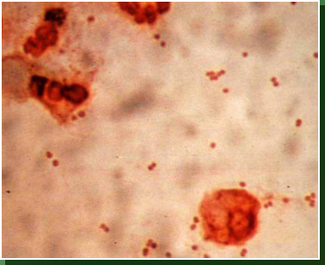
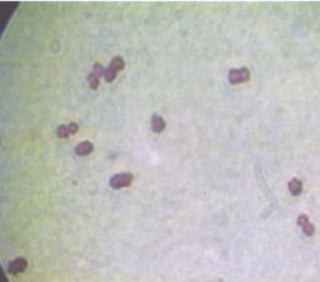
Gram stain of CSF Smear

Slide 48
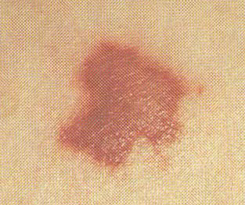
Diagnosis
1. Epidemiologic data:
2 .Clinical manifestations:
3 . Lab findings;

Slide 49
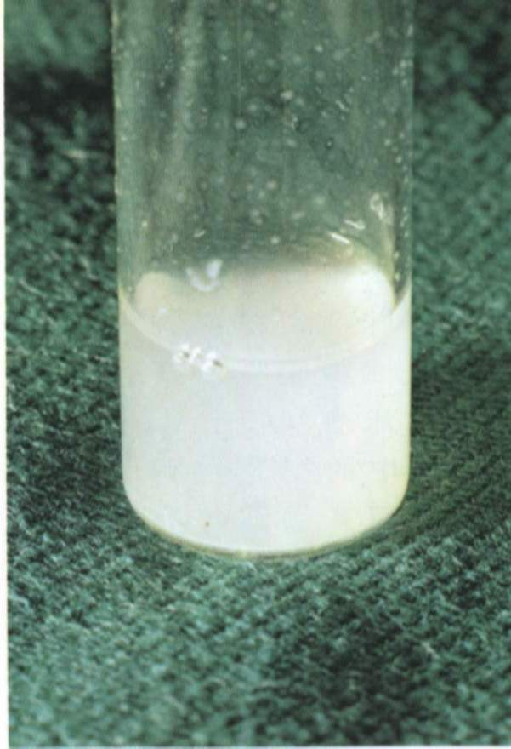
CSF Analysis Of ECM | Pressure 60-180mmH₂O | Obviously Increased
 | Appearence | Turbid
 | Cell counting Classification | >1,000, Neutrophils > 80%
 | Protein | Obviously Increased
 | Glucose Chloride | Obviously Decreased
 | Pathogen | Smear or culture positive
Notes:
80-220 kids
Main gradient is N

Slide 50
Poor prognosis factors
Prognosis
Before antibiotics and immune serum were available, the mortality of meningococcal infection was 70 -90 %
Since the treatment of antibiotics, the mortality rate has dropped to 10-15%.
Common type < 1%.
Fulminant types
Under 2 years old and older
Repeated convulsions, continuous coma
Delayed treatment or incomplete treatment

Slide 51
Commen type
Treatment
General treatment： Isolation, Rest, Intensive care
Symptomatic treatment: anti-fever, sedation, fluid infusion
Pathogen treatment:
Penicillin G
Chloramphenicol
Third generation cephalosporin
As early as possible
Early and appropriate antibiotic treatment markedly improves the outcome of meningococcal infections.

Slide 52
Commen type
Treatment
Penicillin G
ECM is well treated with Penicillin G once the isolate is proven to be penicillin suscepitible.
1988 Resistence to penicillion
High dose injection to achieve effective bactericidal concentration in the CSF
Child: Penicillin G are 20-40,000 U/kg/day
Adults: 4 million U q4h

Slide 53
Commen type
Treatment
Chloramphenicol Adult 100mg/kg/day up to 4g/day,
Child 50mg/kg/day
Pay attention to side effects, be careful with newborns and the elderly
Resistence
Third generation cephalosporin:
ceftriaxone; cefotaxime; cefaclor
A reasonable alternative to penicillin
the excellent efficacy; convenient dosing.
Duration of therapy：
Vary based upon the severity of initial illness and the response of the patient
7 days
myelosuppression

Slide 54
Fulminant types
Treatment
Shock type
Antibiotics
Treatment of shock:
Glucocorticoid?
Vasopressor
Aggressive fluid replacement
Treatment of DIC :
Supportive treatment
heparin, fresh blood, plasma and prothrombin complex, vitamin K
Meningoencephalitis
Antibiotics
Control intracranial hypertension;
Anti-respiratory failure;
Symptomatic treatment;

Slide 55
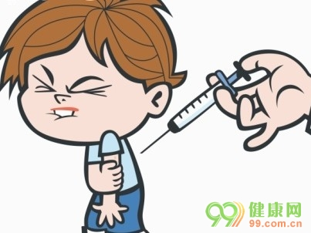
Prevention
Isolation of source of infection;
Block the route of transmission;
Keep indoor air circulation
Protect susceptible population:
Chemoprophylaxis: ceftriaxone, ciprofloxacin or rifampicin;
Vaccination prior to exposure.

Slide 56
Prevention
Meningococcal Vaccines
During outbreaks --reduce the number of secondary cases.
Meningococcal serogroup C conjugate vaccines are used in the UK and other countries
Meningococcal serogroup A conjugate vaccines are used in the Africa
USA Quadrivalent vaccine: A+ C+ Y+W135
China A+C (planned immunization)

Slide 57
Prevention
Antimicrobial chemoprophylaxis
Whom to treat
Close contacts
Travelers who had direct contact with respiratory secretions from an index patient or who were seated directly next to an index patient on a prolonged flight.
Individuals who have been exposed to oral secretions (eg, intimate kissing, mouth-to-mouth resuscitation)
Household members, roommates, intimate contacts
Nasopharyngeal carriage

Slide 58
Prevention
Antimicrobial chemoprophylaxis
Timing of prophylaxis
Ideally <24 hours after identification of the index patient
<14 days
Surveillance of close contacts receiving prophylaxis for at least 10 days following exposure

Slide 59
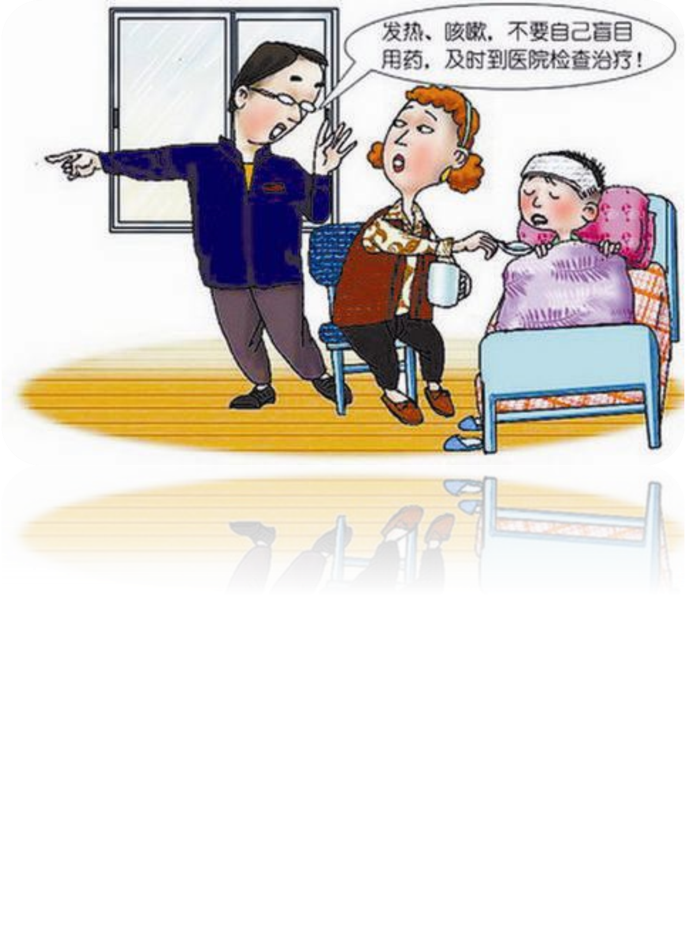
Hospital
Early diagnosis is critical.
A febrile illness+ petechiae +meningeal signs

Slide 60
Physical examination
A careful physical examination should be performed.
The vital signs often show a low blood pressure with an elevated pulse rate.
The patient should be examined for postural hypotension as
a sign of early vascular instability.
Diaphoresis is common.

Slide 61
Physical examination
An intensive search for petechiae and ecchymoses should be undertaken.
The patient should be examined fully undressed.
Sites where pressure is applied to skin by belts are prime locations to find petechiae.

Slide 62
Physical examination
The mucous membranes of the soft palate, ocular, and palpebral conjunctiva must be carefully examined for signs of hemorrhage.

Slide 63
Physical examination
Provocative tests for meningeal irritability should be included.
Kernig and Brudzinski signs.
The absence of signs of meningitis does not exclude the diagnosis of systemic meningococcal infection.

Slide 64
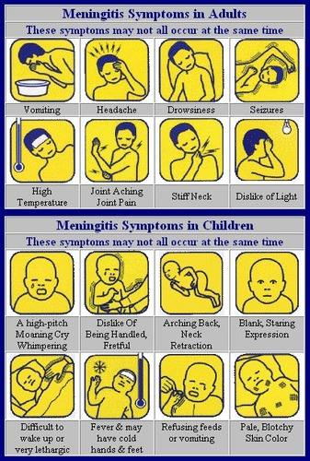
Infant:
meningitis triad (-)
Bulging fontanelle.

Slide 65
Worrisome signs
Signs of sepsis
Leg pain
Cold hands and feet
Abnormal skin color: pallor, mottling

Slide 66
Lumbar puncture
Every patient with suspected meningitis should have CSF obtained unless a lumbar puncture is contraindicated.
Caution should be used in patients with evidence of raised ICP, thrombocytopenia or another bleeding diathesis or spinal epidural abscess.
Mass effect on CNS imaging
Clinical signs of impending herniation

Slide 67
Differential diagnosis
The infection occurs during the late winter, when concurrent influenza is in the community, many cases are mistaken initially for severe “flu”.
Preceding symptoms of pharyngitis can lead to a preliminary misdiagnosis of streptococcal pharyngitis
The initial clinical features are similar to many common, self-limiting viral illnesses.

Slide 68
Differential diagnosis
Heamophilus influenzae
Streptococcus pneumoniae
Focal neurologic signs and seizures are more common.

Slide 69
Differential diagnosis
Tuberculosis Meningitis
Chronic Onset
Characterized by a wide dissemination into the human body and may infect any number of organs, including the lungs, liver, and spleen
Chest x-ray, CT scan, PPD, t-spot

Slide 70
Summary
ECM
Meningococcus
Nasopharygeal
Mucosal
Carriers
upper respiratory tract inflammation
Blood
Septicemia
Purpura, petechiae, ecchymosis
Purulent cerebrospinal meningitis
CSF
Shock
Microcirculatory disorder
DIC
Meningoencephalitis
Brain Edema

Slide 71
Question
1. The pathogen of ECM is:
A. Gram-positive diplococcus
B. Neisseria, Gram-positive, present in the nasopharynx of humans
C. Gram-negative bacilli
D. Gram-negative diplococcus which exclusively infects humans

Slide 72
2. The most important source of infection of ECM is:
A. The current patient
B. Carriers
C. Patients with extreme disease
D. Recovery patients
E. Livestock

Slide 73
3. The main route of transmission of ECM is:
A. Respiratory transmission
B. Digestive tract transmission
C. Insect transmission
D. Close contact
E. Blood fluid transmission

Slide 74
4. The main clinical features of epidemic meningitis are:
A. High fever, headache
B. High fever. Headache. Shock
C. High fever, headache, convulsions
D. High fever, headache, respiratory failure
E. High fever, headache, ecchymosis, meningeal irritation

Slide 75
6. Typical changes in cerebrospinal fluid in epidemic meningitis are:
A. Normal protein, decreased glucose and chloride, and increased cell count
B. Elevated protein, decreased glucose and chloride, and increased cell count
C. Elevated protein, decreased glucose and chloride, and the number of cells are normal.
D. Elevated protein, glucose and chloride are normal, and the number of cells is increased
E. Normal protein, decreased glucose and chloride, and increased cell count

Slide 76
7, Preferred treatment of meningococcal pathogens:
A. Intravenous erythromycin
B. Intravenous injection of chloramphenicol
C. Intravenous SMZCO
D. Intravenous infusion of small doses of penicillin
E. High dose intravenous penicillin

Slide 77
Thanks

