Slide 1
HEMORRHAGIC FEVER
WITH RENAL SYNDROME
Zhihua Liu Ph.D.&M.D.
zhihualiu@126.com
Department of Infectious Diseases
Nanfang Hospital

Slide 2
OUTLINE
Etiology
Epidemiology
Pathogenesis and Pathology
Clinical Manifestations
Laboratory Examinations
Diagnosis
Treatment
Prevention

Slide 3
Introduction
Hemorrhagic fever with renal syndrome, also known as epidemic hemorrhagic fever
Caused by hantavirus from family Bunyaviridae
Carried and transmitted by rodents, especially wild rats
Clinically characterized by fever, hemorrhage and renal disorders, usually progresses through five phases, i.e. febrile, hypotensive, oliguric, diuretic and convalescent phases

Slide 4
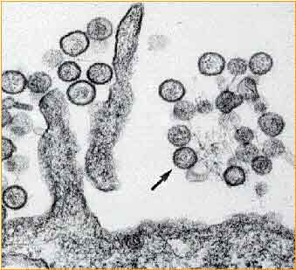
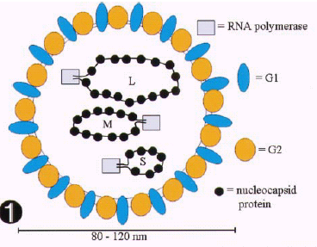
Etiology
Hantavirus:
Classification:
  Bunyaviridae family
Morphology:
  spherical, 80-120nm in diameter
Genome:
  (-) single strand RNA
  Tri-segmented genome
  large: RNA dependent RNA polymerase
  medium: viral glycoproteins
  small: nucleocapsid protein

Slide 5
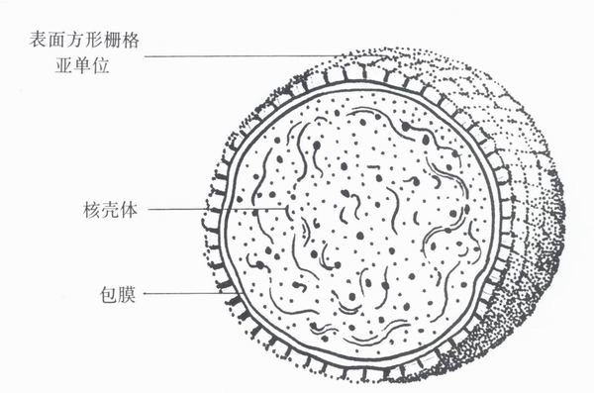
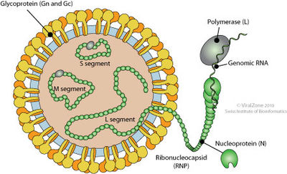
ETIOLOGY
Structure
  Viral envelop:
    lipid bilayer+ viral surface protein
  Nucleocapsid
    Nucleocapsid protein
    Viral genome
    RNA polymerase

Slide 6
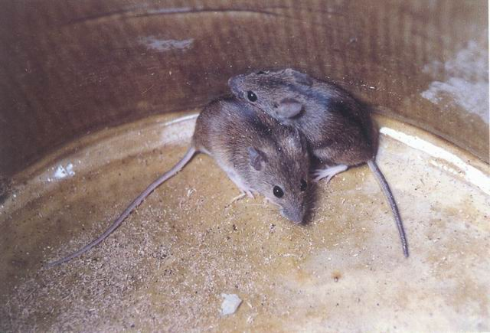
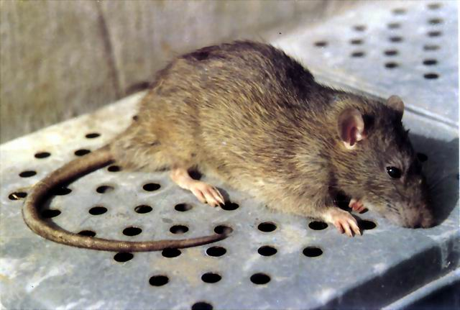
EPIDEMIOLOGY
Source of infection
  Rodents: mice or rats
  Other vibrate animals: cats, dogs, pigs
  Human: human-to-human transmission?
褐家鼠

Slide 7
EPIDEMIOLOGY
Route of transmission
  Contact transmission
  contact with infected animal excreta
  rodent bite
  skin breaches
  Respiratory tract
    Aerosolized rodent excreta, urine, feces, saliva
  Alimentary tract
    food or water contaminated by infected rodents
  Verticle transmission (spread from mother to fetuses)
  rare event, not important in epidemiology

Slide 8

Transmission of Hantaviruses
Chronically infected rodent
Horizontal transmission of infection between same species by contact
Virus is present in aerosolized excreta, particularly urine
Secondary aerosols, mucous membrane contact, and skin breaches are also a consideration

Slide 9
EPIDEMIOLOGY
Susceptibility
  Universal susceptibility
  Stable and persistant immunity
  Subclinical infection:2.5%-4.3%

Slide 10
EPIDEMIC FEATURE
Epidemic features
  Geographic distribution
  Asian and European countries
  China is one of most seriously affected countries
  40,000~60,000 cases annually
  Seasonal Distribution: Nov.-Jan., Mar.-Jun.
  Distribution of population:
  age:20-40 years old
  gender: male>female, M:F 2:1-3:1
  occupation: farmer, worker in forest, soldier

Slide 11
Pathogenesis
Pathogenesis of disease
1. Direct injury of virus
Viremia– toxic symptoms
Bone marrow cells-- injury
Endothelial cells-- injury

Slide 12
Pathogenesis
2. Immunity injury
  allegic reaction of type III
immune complex
  allegic reaction of type Ⅰ,Ⅱ
  T-cell response: Cytotoxic T Lymphocyte (CTL)
  Cytokine and medium injury
  IL-1, TNFα, IFNγ

Slide 13
Pathophysiology of symptoms
Shock
hantavirus injury of blood vessel
vascular permeability
exudation of plasma
effective blood volume
shock

Slide 14
Pathophysiology of symptoms
Hemorrhage
  Vascular injury
  Thrombocytopenia
  diffuse intravascular coagulation(DIC)
  Platelet dysfunction

Slide 15
Pathophysiology of symptoms
Renal failure
  Glomerular filtration rate (GFR)
  Immunity injury of kidney
  Cast obstruction in renal tubules
  Interstitial edema pressing renal tubules
Notes:
A number of conditions are involved in the pathogenesis of acute renal failure, including

Slide 16
Pathology
Basic pathologic lesion
  Extensive lesion of the systemic small blood vessels
  Intensive capillary engorgement
  Diapedesis of erythrocytes
  Focal hemorrhages
  Altered capillary permeability
Gross pathologic lesions
  Retroperitoneal edema
  Diffuse hemorrhage in the right atrium of the heart
  Severe congestion, hemorrhage and infarct-like necrosis in the renal medulla
  Hemorrhage and necrosis in the anterior lobe of the pituitary gland
Notes:
The characteristic findings are:

Slide 17
Clinical manifestations
Incubation period: 2-7 weeks, average 7-14 days
Five phases:
  Febrile phase
  Hypotention-shock phase
  Oliguric phase
  Diuretic phase
  Convalescent phase

Slide 18
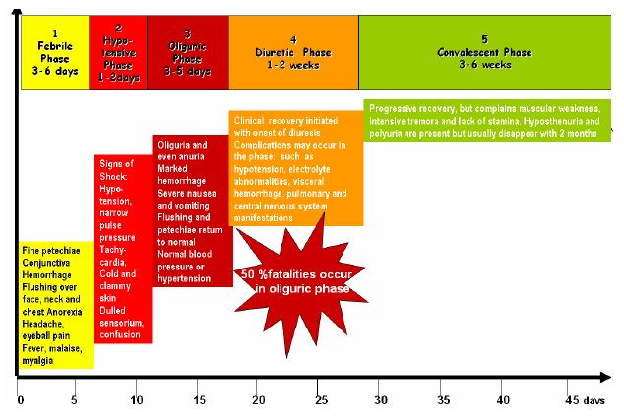
Clinical course and symptoms of HFRS

Slide 19
Clinical manifestations
Febrile phase: fever, suffusion and bleeding, renal impairment
    Fever:3~7 days, high, unremitting
    Three pains: headache, lumbago (backache), orbital pain
    Three reds:
    conjunctival suffusion;
    flush over face;
    flush over neck and upper chest

Slide 20
Clinical manifestations
Hemorrhage:
    Mucosa: conjunctivae,
    Palate: petechiae
    Skin: axillary folds, chest and back petechiae
    Internal organs
Exudative edema:
    Chemosis; eyelid edema;
Renal injury:
proteinuria, hematuria or cast
Notes:
Petechia may occur in the axilla and soft palate.

Slide 21
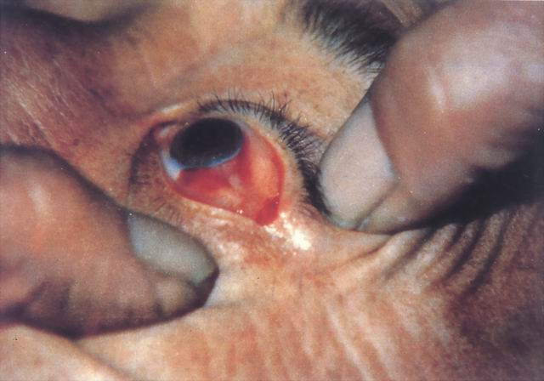
male, 34 years old, 2 days after illness, hemorrhage in conjunctiva of left eye， Chemosis

Slide 22
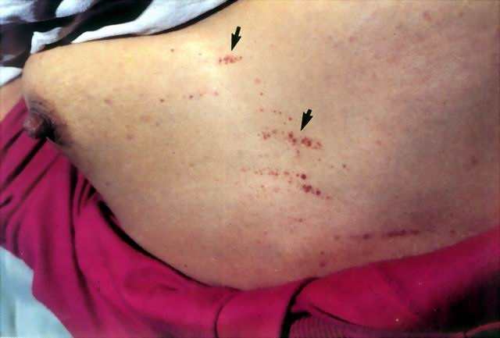
female，31 years old，4 days after illness, petechiae in the skin of chest and abdomen↑

Slide 23
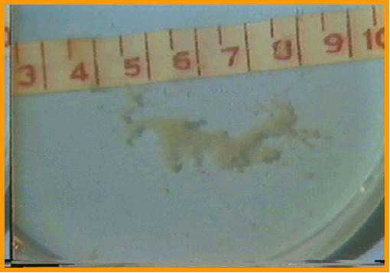
Membranoid substance in urine
Severe kidney injury

Slide 24
Clinical manifestations
2.Hypotension-shock phase:
4~6 days after illness
    Mild case: transient fall in blood pressure
    Moderate and severe case: hypotension and shock persists for 1-3 days
    Systolic pressure decreases:<90mmHg
    Cold and moist skin and extremities
    Pulse pressure narrows

Slide 25
Clinical manifestations
3. Oliguric Phase:
about 5~8 days after illness,last 2~5days
Acute kidney injury,
    Oliguria: urine volume in 24h <500ml
    Anuria: urine volume in 24h <50ml
    Uremia
    Symptoms of digestive tract:
    anorexia, nausea,vomiting, diarrhea
    Symptoms of nervous system
    headache, lethargy,dysphoria
    BUN increases, electrolyte abnormalities, acidosis
    Hemorrhage manifestations become more prominent

Slide 26
Clinical manifestations
  Disturbance of water and electrolyte balance
    Hyperkalemia, hyponatremia,
    exudative edema
    chemosis, edema of eyelid, ascites
  High blood volume syndrome
    Venous engorgement
    Pulse enlargement
    Pulse pressure increase
    Severe edema
    (heart failure, pulmonary edema)

Slide 27
Clinical manifestations
4. Diuretic Phase:
9-14 days after illness, lasts 7~14 days
  Diuresis: urine volume >2000ml/24h
    Transitional phase
    urine volume:500~2000ml/24h
    Early period of diuresis
    2000ml~3000ml/24h, azotemia symptom
    Late period of diuresis
    >3000ml/24h
    dehydration
    hyponatremia, hypokalemia
    secondary infection

Slide 28
Clinical manifestations
5. convalescent phase (1-3 months)
  Urine volume <2000ml/24 hours

Slide 29
Clinical types
Mild type
Moderate type
Severe type
Dangerous severe type
Non-typic

Slide 30
Laboratory findings
Blood routine examination
Leukocytosis: WBC 15~30×10⁹
heteromorphic lymphocyte >15%
Thrombocytopenia
Urine routine examination
    Proteinuria
    Hemoturia RBC
    Cast
    Membranoid substance

Slide 31
Laboratory findings
Serological examination
    Specific antigen
    serum, WBC, urine
    Direct immuofluorescence
    Specific antibody: IgM antibody, IgG antibody
    Enzyme immunoassay (EIA)
    Indirect flurescent assay (IFA)
    Pathogenic examination
    Isolation of virus: difficult and time consuming
    RT-PCR: viral RNA
    early diagnosis of Hantavirus infection

Slide 32
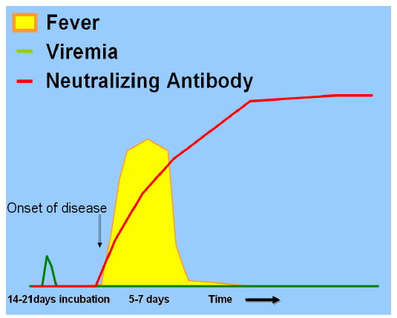
Viremia and antibody response in human hantavirus infection

Slide 33
DIAGNOSIS
Epidemiologic data
  Living or traveling in epidemic region
  Contact with rodent excreta
Clinical features:
  Three main symptoms
  Five phases
Lab findings
    Leukocytosis, thrombocytopenia, high percent heteromorphic lymphocyte
    proteinuria
    Specific antibody
    IgM antibody 1:20 positive
    IgG antibody 1:40 positive
    four fold rise

Slide 34
Treatment
The principle of therapy
  Early diagnosis
  Recognizing timely
  Treatment rapidly and in site
    Hospitalized and kept in bed
    Avoid movement by vehicles
    Monitored intensively
    Antipyretic drug
    Supportive therapy

Slide 35
Treatment
Febrile phase
  Controlling infection: ribavirin, as early as possible
  Relieve permeability of blood vessel
    Hemostatic
    Vitamin C
    Mannitol
  Alleviate toxic symptom:
    High fever: physical cooling
    Toxic symptom:
    Glucocoticoid: dexamethasone,hydrocortisone

Slide 36
Treatment
Hypotensive phase
  Supplement of blood volume
    Early, fast, suitable volume
    Crystalloid solution plus colloidal solution
    crystalliod solution: normal saline solution,
    compound sodium acetate
    colloidal solution: plasma, human albumin
    crystalliod: colloidal 3~4:1
  Correction of acidosis
    5% sodium bicarbonate (NaHCO3)
  Vaso-active agent
    Dopamine: 100~200mg/L

Slide 37
Treatment
Oliguric peroid
  Principle of treatment:
  Stabilization of internal environment
  Promoting diuresis
  hemodialysis
  Treating and preventing complications

Slide 38
Treatment
  Stabilization of internal environment
  keeping the water, electrolytes and acid-base in the body in the physiology range
    Input solution should be limited at a rational extent
    output volume plus 500-800ml

Slide 39
Treatment
  Diuresis
  started 12~24 hours after the blood pressure become stable
    Loop diuretics: furosemide, bumetanide
  Dialysis hemodialysis- the most effective therapeutic methods for acute renal failure
  indications for hemodialysis:
    Oliguria > 5 days or anuria> 2 days
    Hypervolemia syndrome with pulmonary edema, cerebral edema
    Hyperkalimia
    Disease progress rapidly

Slide 40
Treatment
Diuretic phase
  electrolytes unbalance
  Dehydration
  Infection
Convalescent phase
  Nutrition, functional exercise

Slide 41
Prevention
Rodent control in highly endemic areas
Avoid contacts with the host rodents
Vaccine
Inactived hantavirus vaccines used in China
Notes:
Widely used and have been demonstrated safe and effective in China.

Slide 42
Summary
HFRS is a group of diseases with fever, hemorrhage and renal injury
Pathogen: Hantaviruses
HFRS consists of five phases:
  Febrile, hypotention, oliguric, diuretic, convalescence

Slide 43
THANK YOU!

