Slide 1
Influenza
Zhihua Liu
Department of Infectious Diseases, Nanfang Hospital

Slide 2
Influenza
A contagious respiratory illness
Influenza virus , an acute respiratory tract infectious disease
Occurs in outbreaks of variable severity
Clinical manifestations:
fever,cough, headache, muscle and joint pain, sore throat
Two important feature:
high epidemic nature
mortality that results from its pulmonary complications

Slide 3
OVERVIEW
Etiology
Epidemiology
Clinical Menifestations
Diagnosis and Treatment
Prophylaxis

Slide 4
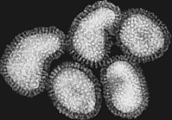
Etiology
RNA, enveloped
Viral family: Orthomyxoviridae
Size:
80-200nm or .08 – 0.12 μm (micron) in diameter
Three types
  A, B, C
Credit: L. Stammard, 1995
Surface antigens
  H (haemaglutinin)
  N (neuraminidase)

Slide 5
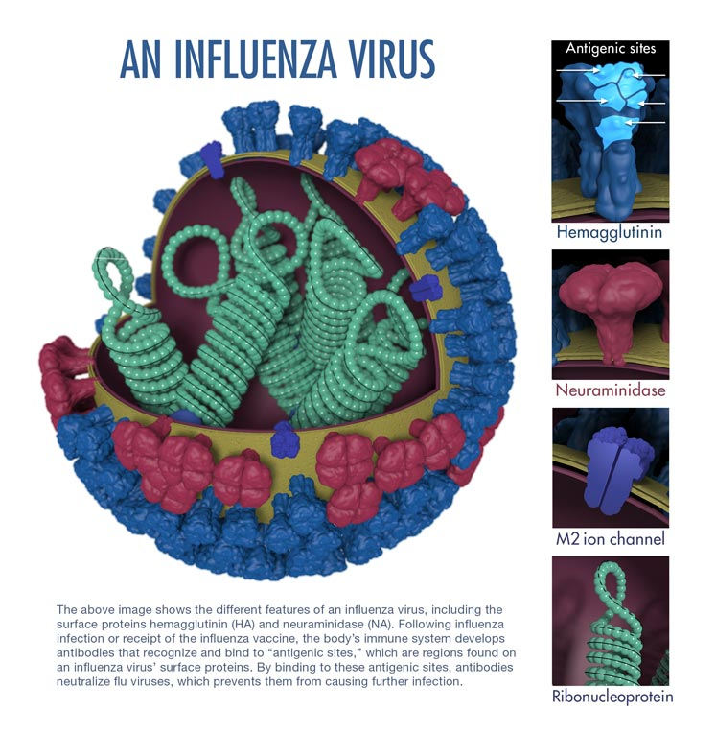
Structure of Viron
Influenza virions are SMALL. The average eukaryotic cell diameter is 10,000 nm
(10 microns), which is 100 times bigger than the influenza virion diameter.

Slide 6
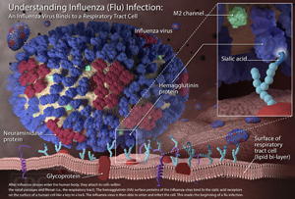

Slide 7
Influenza Subtypes
Influenza Subtypes
Types A & B
8 Segments of RNA
Responsible for epidemics & pandemics
Type C
7 Segments of RNA
Causes only mild infections
Influenza strains are subtyped A, B, or C based on the relatedness of the matrix (M1) and nucleoprotein (NP) antigens
All 3 subtypes can infect human, subtype A can also infect other mammals and birds
Within each subtype, there are many variant strains

Slide 8
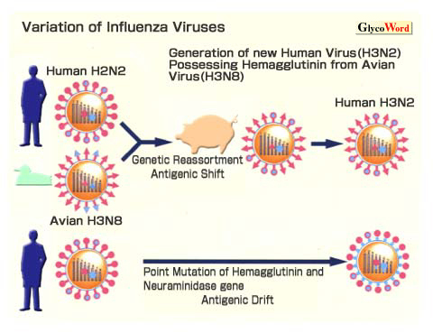
Antigenic variation
Antigenic drift
  point mutation in the viral genes cause minor antigenic change
  mutation rate highest for type A
  most meaningful mutations occur in HA protein
  Cause seasonal epidemic

Slide 9
Antigenic variation
Antigenic shift
  emergence of new strains of virus through Genetic reassortment between circulating human and animal strains
  Immunologically distinct, novel H/N combinations
  Pandemic can occur
  Only been observed in type A, since it infects many species

Slide 10
Epidemiology
Source of Infection
Patients with influenza, inapparent infected persons

Slide 11

Contagiousness
Influenza is a highly contagious disease
Individuals are contagious for 1 to 4 days before the onset of symptoms and about 5 days after the first symptoms
  Peak viral shedding - first 3 days of illness
Subsides usually by 5-7th day in adults
  can be 10+ days in children
Approximately 50% of infected people do not present any symptoms but are still contagious

Slide 12
Modes of Transmission
Three modes of transmission include:
  Droplet transmission
  Airborne transmission
  Contact transmission

Slide 13

Droplet Transmission
Droplet transmission occurs when contagious droplets produced by the infected host through coughing or sneezing are propelled a short distance and come into contact with another person’s
  conjunctiva,
  mouth, or
  nasal mucosa.

Slide 14

Airborne Transmission
Airborne transmission occurs when viruses travel on dust particles or on small respiratory droplets that may become aerosolized when people sneeze, cough, laugh, or exhale.
  They can be suspended in the air much like invisible smoke.
  They can travel on air currents over considerable distances.

Slide 15

Contact Transmission
Two Types
  Direct: involves body-to-body surface contact
  Indirect: occurs via contact with contaminated intermediate objects, such as contaminated hands, or inanimate objects (fomites), such as countertops, door knobs, telephones, towels, money, clothing, dishes, books, needles etc.

Slide 16
Susceptible population
Crowd are generally susceptible to influenza virus
Immunity after illness: within a subtype, short term
No cross protection among distinct types and subtypes

Slide 17
Epidemic features
Influenza A: outbreak, pandemic, worldly pandemic
Influenza B: fulminant or small prevalence
Influenza C: rarely give rise to epidemics

Slide 18
Flu Pandemics
1918-spanish influenza
1957-Asia influenza
1968-Hongkong influenza

Slide 19
1918 Flu Pandemic Facts:
May have killed as many people as the Black Death- bubonic plague
The majority of deaths were from a secondary infection such as bacterial pneumonia
It killed between 2 and 20 % of those infected; normal mortality rate is 0.1 %
It mostly killed young adults with more than half of the deaths in people between 20 - 40 years old due to novel surface proteins on the virus.
It killed as many as 25 million in the first 25 weeks, whereas HIV/AIDS has killed 25 million in the first 25 years.

Slide 20
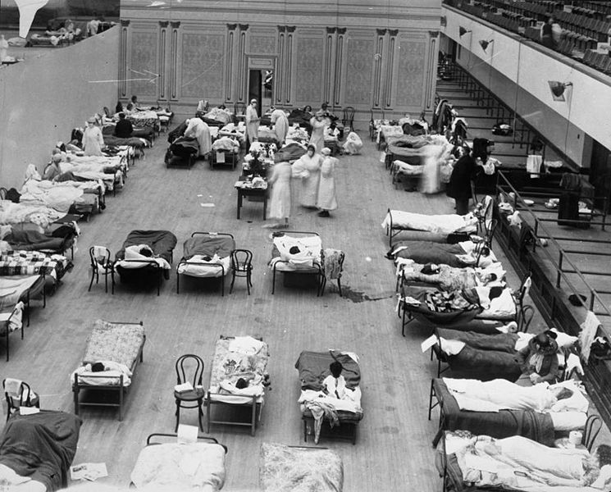

1918 Flu Pandemic
American Red Cross nurses tend to flu patients in temporary wards set up inside the Oakland municipal Auditorium.
http://en.wikipedia.org/wiki/Image:1918_flu_in_Oakland.jpg

Slide 21
1918 Spanish Flu
Mortality rate was 2.5%, other epidemics had been 0.1%
Unusually, most deaths associated with young, healthy adults
Researchers isolated a wide selection of bacteria – virus for influenza unknown
  Years later, H1NI strain found responsible for infection
  However, bacteria responsible for the severe secondary complications of pneumonia causing death

Slide 22
Clinical manifestations
Incubation period: 1-3 days
Typical influenza:
  Systemic toxic symptoms :
  Sudden onset of chills and fever Sore throat, dry cough
  Fatigue, lack of energy
  muscle aches, headaches
  nasal congestion, runny nose
  Stomach-intestine symptoms: nausea, diarrhea, vomiting

Slide 23
Primary Viral Pneumonia
older age, baby, person with chronic disease
aggravates rapidly
Ardent fever, the exhaustion, intense cough, urgent breathe, cyanochroia
Double lungs are studded by moist rales
no pathogenic bacteria in the sputum

Slide 24
Complications
A bacterial “superinfection”
  Bacterial upper respiratory infection, tracheitis, bronchitis, becterial pneumonia.
Other complications: myositis, cardiac complications, toxic shock syndrome, Reye’s Syndrome
http://www.ecureme.com/atlas/version2001/atlas.asp

Slide 25
Laboratory Diagnostic Procedure
Respiratory samples:
  nasopharyngeal or nasal swab, nasal wash or aspirate
  Collected within the first 4 days of illness
Diagnostic test
  Viral culture, serology, rapid antigen testing, RT-PCR, immunoflurescence assay

Slide 26
Pathogen Examination
Viral isolation:
  Samples: nasopharyngeal or throat swabs, nasal wash, or nasal aspirates.
  Time: the first four days of infection.
  Culture: monkey kidney cell
Rapid Influenza Diagnostic Tests (RIDTS)
RT-PCR Detection of nucleic acid
Serologic testing

Slide 27
Diagnosis
Epidemiology data
Clinical symptom
systemic toxic symptoms,
respiratory tract symptoms
Laboratory test-definitive diagnosis
increase in antibody titer
positive result in detection of nucleic acid or viral antigen

Slide 28
Treatment
Main treatment in uncomplicated influenza: symptomatic and supportive
Increase liquid intake
Get plenty of rest
Anti-fever drugs
Anti-viral drugs

Slide 29
Anti-viral drugs
Ion channel M2 blocker- amantadine and rimantadine
  effective against influenza A viruses
  Preclude the virus from attaching host cells
  High level resistance to amantadine among influenza A
Neuramidinase inhibitor
  Oral oseltamivir, inhaled zanamivir, intravenous peramivir
  effective against influenza A viruses and influenza B viruses

Slide 30
TABLE 1. Recommended dosage and schedule of influenza antiviral medications* for treatment
Antiviral agent |  | Age group (yrs)
 |  | 1--6 | 7--9 | 10--12 | 13--64 | ≥65
Zanamivir | Treatment, influenza A and B | NA | 10 mg (2 inhalations) twice daily | 10 mg (2 inhalations) twice daily | 10 mg (2 inhalations) twice daily | 10 mg (2 inhalations) twice daily
Oseltamivir¶ | Treatment,** influenza A and B | Dose varies by child's weight** | Dose varies by child's weight** | Dose varies by child's weight** >40 kg = adult dose | 75 mg twice daily | 75 mg twice daily
Abbreviation: NA = not approved

Slide 31
Influenza Antiviral Treatment Recommendations
Clinical trials and observational data show that early antiviral treatment can shorten the duration of fever and illness symptoms, and may reduce the risk of complications from influenza (e.g., otitis media in young children, pneumonia, and respiratory failure).
Early treatment of hospitalized patients can reduce death.
In hospitalized children, early antiviral treatment has been shown to shorten the duration of hospitalization.
Clinical benefit is greatest when antiviral treatment is administered early, especially within 48 hours of influenza illness onset.
Antiviral treatment is recommended as early as possible for any patient with confirmed or suspected influenza who:
  is hospitalized;
  has severe, complicated, or progressive illness; or
  is at higher risk for influenza complications.
Notes:
Summary of Influenza Antiviral Treatment Recommendations
Clinical trials and observational data show that early antiviral treatment can shorten the duration of fever and illness symptoms, and may reduce the risk of complications from influenza (e.g., otitis media in young children, pneumonia, and respiratory failure).
Early treatment of hospitalized patients can reduce death.
In hospitalized children, early antiviral treatment has been shown to shorten the duration of hospitalization.
Clinical benefit is greatest when antiviral treatment is administered early, especially within 48 hours of influenza illness onset.
Antiviral treatment is recommended as early as possible for any patient with confirmed or suspected influenza who:
is hospitalized;
has severe, complicated, or progressive illness; or
is at higher risk for influenza complications.

Slide 32
Prophylaxis
Most effective ways of prevention: vaccine
The only proven method for preventing influenza--yearly vaccination approximately 2 weeks before the “flu season” begins.
new vaccines that consist of different influenza strains need to be developed each year
vaccine composition: targets the 3 (trivalent) most representative virus types in circulation (two subtypes of influenza A viruses and one B virus).

Slide 33
Prophylaxis
Vaccination is especially important for people at higher risk of serious influenza complications, and for people who live with or care for high risk individuals.
WHO recommend annual vaccination for
  Eldly individuals(>65 years of age),
  Children aged of 6 months to 5 years
  pregnant woman at any stage of pregnancy
  patients with chronic disease
  Health care worker

Slide 34
2016-2017 influenza vaccination recommendation
Everyone 6 months and older is recommended for annual flu vaccinat ion with rare exception.
People who can get the flu shot: | People who can't get the flu shot:
Different flu shots are approved for people of different ages, but there are flu shots that are approved for use in people as young as 6 months of age and up. Flu shots are approved for use in pregnant women and people with chronic health conditions. | Children younger than 6 months are too young to get a flu shot. People with severe, life-threatening allergies to flu vaccine or any ingredient in the vaccine. This might include gelatin, antibiotics, or other ingredients..

Slide 35
Human Avian Influenza (Highly Pathogenic)
Zhihua Liu
Department of Infectious Diseases
Nanfang Hospital

Slide 36
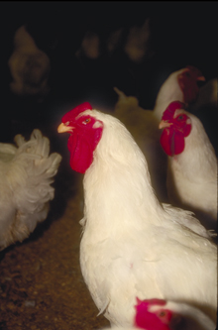
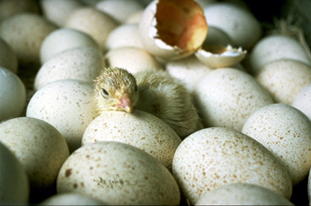
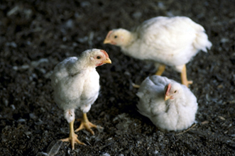
Overview
Etiology
Epidemiology
Transmission
Clinical Manifestations
Diagnosis and Treatment
Prevention and Control
Notes:
In today’s presentation we will cover information regarding the organism that causes highly pathogenic avian influenza virus and its epidemiology. We will also talk about the economic impact the disease has had in the past and could have in the future. Additionally, we will talk about how it is transmitted, the species it affects, clinical and necropsy signs seen, as well as diagnosis and treatment of the disease. Finally, we will address prevention and control measures for the disease and actions to take if highly pathogenic avian influenza virus is suspected.

Slide 37
Human avian influenza
Avian influenza: “bird flu”, infectious viral disease of bird
Human avian influenza: human infection with avian influenza, most commonly with a highly pathogenic avian influenza, such as H5N1, H7N9

Slide 38
Avian influenza virus
Orthomyxoviridae influenza A virus
External coat spike: hemagglutinin(HA),Neuraminic acid (NA)
16 H subtyps and 9 N subtypes

Slide 39
Avian Influenza Virus
Pathogenicity based on genetic features and/or severity of disease
in poultry
  Low pathogenic AI (LPAI)
    H1 to H16 subtypes
  Highly pathogenic AI (HPAI)
    Some H5 or H7 subtypes
    LPAI H5 or H7 subtypes can mutate
    into HPAI
Notes:
Avian influenza viruses only include type A viruses and are described based on their pathogenicity. Genetic features and/or severity of disease in poultry determines whether the virus is classified as low pathogenic (LPAI) or high pathogenic (HPAI) avian influenza. Low pathogenic avian influenza (LPAI) includes viruses in all H1 to H15 subtypes. On the other hand, highly pathogenic avian influenza (HPAI) have traditionally been either H5 or H7 subtypes. H5 and H7 LPAI viruses do exist and are of concern because they can mutate into a HPAI.

Slide 40
Epidemiology

Slide 41
Human Transmission
Previously considered non-pathogenic for humans
1997, Hong Kong
  18 humans infected, 6 died
  H5N1 virus linked to outbreak in live
  bird market and area farms
2003, the Netherlands
  83 confirmed cases in humans, 1 death
  H7N7 strain
Notes:
AI viruses were once thought to be nonpathogenic for humans because humans lack receptors for avian influenza viruses (locations that the virus utilizes to attach for infection to occur). However, in 1997, 18 people were infected and six people died from a highly pathogenic H5N1 strain of avian influenza virus in Hong Kong. The virus was linked to birds in a live bird market and on farms that were experiencing an outbreak of HPAI. An outbreak in the Netherlands in early 2003 resulted in 83 confirmed cases of avian influenza in humans. A 57 year old veterinarian who visited a poultry farm affected by the H7N7 strain died of acute respiratory distress syndrome and H7N7 was isolated from the patient; he was the only death known from that outbreak.

Slide 42
Human Transmission
2004-2005, SE Asia
  118 cases, 61 deaths
    Indonesia, Viet Nam, Thailand, Cambodia
  H5N1 strain
  Within the vicinity of poultry outbreaks
  Evidence for human-to-human transmission
Role of swine
  Proposed “mixing vessel”
Notes:
A 2004-2005 outbreak of the H5N1 strain in Southeast Asia has resulted in human cases and deaths (118 cases and 61 deaths as of October 20, 2005), in the countries of Indonesia, Viet Nam, Thailand, and Cambodia combined. The majority of reported cases had close contact or exposutee to poultry or came from locations of poultry avian influenza outbreaks. In Viet Nam, human cases have been reported in clusters of family members, which may suggest human-to-human transmission may have occurred; typically this is rare. Contact with sick poultry still remains the major risk factor for human transmission.
Swine have been proposed as a “mixing” vessel for co-infection by influenza viruses from birds and mammals because they have receptors for both mammalian and avian influenza viruses. This co-infection with avian and mammalian influenza viruses can lead to the development of new strains (reassortants) that could have the ability to infect people and other mammals.

Slide 43
Source of Infection
  Avian species infected with HPAI
  No human-to-human transmission identified

Slide 44
Route of transmission
  respiratory track: inhalation of infectious droplets and droplet nuclei
  Close contact: body fluid, excreta of poultry

Slide 45
High-risk Group
  people engaged in poultry breed
  People have been to the places of poutry raising, selling, and slaughtering
  Laboratory staff who contact the avian influenza virus
  The personnel who has the close contact with avian influenza patients

Slide 46
Human infection HPAI- H5N1
H5N1, Asia
  1997:Hongkong,18 humans infected, 6 died
  Risk factor: visiting live poultry market
  2003:Hongkong (2 case, 1 death)
  2004:Vietnam, Thailand, Cambodia (55 cases, 42 death)
  Overall case fatality rate:65%
Notes:
AI viruses were once thought to be nonpathogenic for humans because humans lack receptors for avian influenza viruses (locations that the virus utilizes to attach for infection to occur). However, in 1997, 18 people were infected and six people died from a highly pathogenic H5N1 strain of avian influenza virus in Hong Kong. The virus was linked to birds in a live bird market and on farms that were experiencing an outbreak of HPAI. An outbreak in the Netherlands in early 2003 resulted in 83 confirmed cases of avian influenza in humans. A 57 year old veterinarian who visited a poultry farm affected by the H7N7 strain died of acute respiratory distress syndrome and H7N7 was isolated from the patient; he was the only death known from that outbreak.

Slide 47
Human infection HPAI- H7N9
2013, mainland China
  130 cases, 37 deaths
    Shanghai, Jiangsu, Anhui
  H7N9 strain
  Sporadic case
  no evidence for human-to-human transmission
Notes:
A 2004-2005 outbreak of the H5N1 strain in Southeast Asia has resulted in human cases and deaths (118 cases and 61 deaths as of October 20, 2005), in the countries of Indonesia, Viet Nam, Thailand, and Cambodia combined. The majority of reported cases had close contact or exposutee to poultry or came from locations of poultry avian influenza outbreaks. In Viet Nam, human cases have been reported in clusters of family members, which may suggest human-to-human transmission may have occurred; typically this is rare. Contact with sick poultry still remains the major risk factor for human transmission.
Swine have been proposed as a “mixing” vessel for co-infection by influenza viruses from birds and mammals because they have receptors for both mammalian and avian influenza viruses. This co-infection with avian and mammalian influenza viruses can lead to the development of new strains (reassortants) that could have the ability to infect people and other mammals.

Slide 48
Incubation period
Generally 1-7 days

Slide 49
Clinical Manifestations
High fever
Influenza-like symptoms:
cough, headache, muscle pain, general malaise
Diarrhea, vomiting
abdominal pain, chest pain
severe cases
bilateral pneumonia, difficulty breathing, ARDS
multi-organ dysfunction syndrome
death

Slide 50
Laboratory Examination
Peripheral hemogram
  White cell count: not high or reduced
  severe case: leukopenia, lymphopenia, thrombocytopenia
Viral antigen and the gene detection
  Immunofluorescence
  RT-PCR
Viral isolation
Serologic examination
>four-fold increase in the titer of the antibody

Slide 51
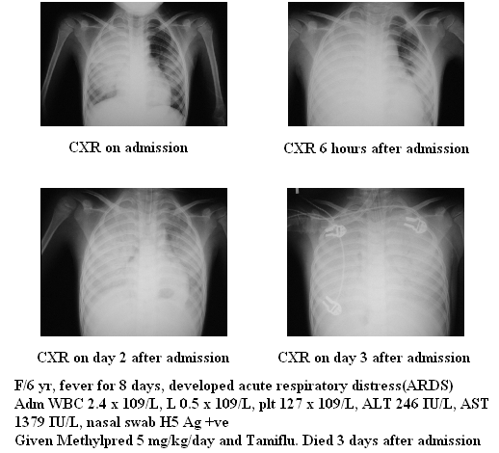
Imaging investigation
Notes:
AI viruses were once thought to be nonpathogenic for humans because humans lack receptors for avian influenza viruses (locations that the virus utilizes to attach for infection to occur). However, in 1997, 18 people were infected and six people died from a highly pathogenic H5N1 strain of avian influenza virus in Hong Kong. The virus was linked to birds in a live bird market and on farms that were experiencing an outbreak of HPAI. An outbreak in the Netherlands in early 2003 resulted in 83 confirmed cases of avian influenza in humans. A 57 year old veterinarian who visited a poultry farm affected by the H7N7 strain died of acute respiratory distress syndrome and H7N7 was isolated from the patient; he was the only death known from that outbreak.

Slide 52
Prognosis
Severe case: extremely poor
Prognosis factors:
  age
  Underlying diseases
  complications

Slide 53
Diagnosis
Epidemiology contact history
  Exposure history to patients with acute respiratory infection or exposure history to poultry
Clinical manifestation
  Acute febrile respiratory symptoms
Laboratory examination

Slide 54
Diagnostic criteria
a) Suspected case: clinical symptoms consistent with acute influenza (fever, cough, coryza, difficulty breathing) and a laboratory test positive for infection with an untyped influenza A virus or with a history of contact with a confirmed or suspected case.
b) Confirmed case: clinical symptoms consistent with acute influenza (fever, cough, coryza, difficulty breathing) or with a history of contact with a confirmed or suspected case and a laboratory test positive for avian influenza A (H7N9) virus; PCR, viral isolation or a four-fold or greater increase in serum antibodies specific for this virus isolated in paired sera.
Severe case: a confirmed case with pneumonia complicated by respiratory failure or other organ failure.

Slide 55
Treatment
Isolation
Symptomatic treatment: Oxygen, antipyretics
Antiviral treatment
Principle of antiviral treatment:
1. Before the use of antiviral drugs, respiratory specimens should be collected.
2. Antiviral drugs for influenza should be initiated within 48 hours of symptom onset.
3. If more than 48 hours have passed since symptom onset, anti-viral drugs may still provide some benefit and should be considered in cases with severe disease or deterioration.

Slide 56
Treatment
  Neuramidinase inhibitor-Oseltamivir
  -for adult: 75mg 2/DAY 5 days
  -for children 15kg: 30mg 2/day
  15-23kg: 45mg 2/day
  23-40kg: 60mg 2/day
  40kg: 75mg 2/day
  Ion channel M2 blocker: not recommended because of widespread resistances
    Amamtadine
    rimantadine

Slide 57
Treatment
Treatment of severe cases:
oxygen therapy
other respiratory support: mechanical ventilation
proper treatment for other complications

Slide 58
Prevention
Srengthen the avian disease monitor
Strengthen the monitor for the close-contact-avian personnel
Standardize the hospital infection control measure
Isolation treatment for patients

Slide 59
THANK YOU!

