Slide 1
Measles and Mumps
Xieer Liang, MD & Ph.D
kuaiyi@smu.edu.cn
Hepatology Unit and Department of Infectious Diseases
Nanfang Hospital, Southern Medical University

Slide 2
Outline
Measles
Mumps

Slide 3
Measles: overview
Viral disease
Clinical findings
Fever
Catarrhal inflammations
Koplik’s spots
Maculopapules
Vaccines preventable

Slide 4
Medicine History
Galen: 165-180, smallpox or measles
Rhazes: 860-932, measles and smallpox

Slide 5
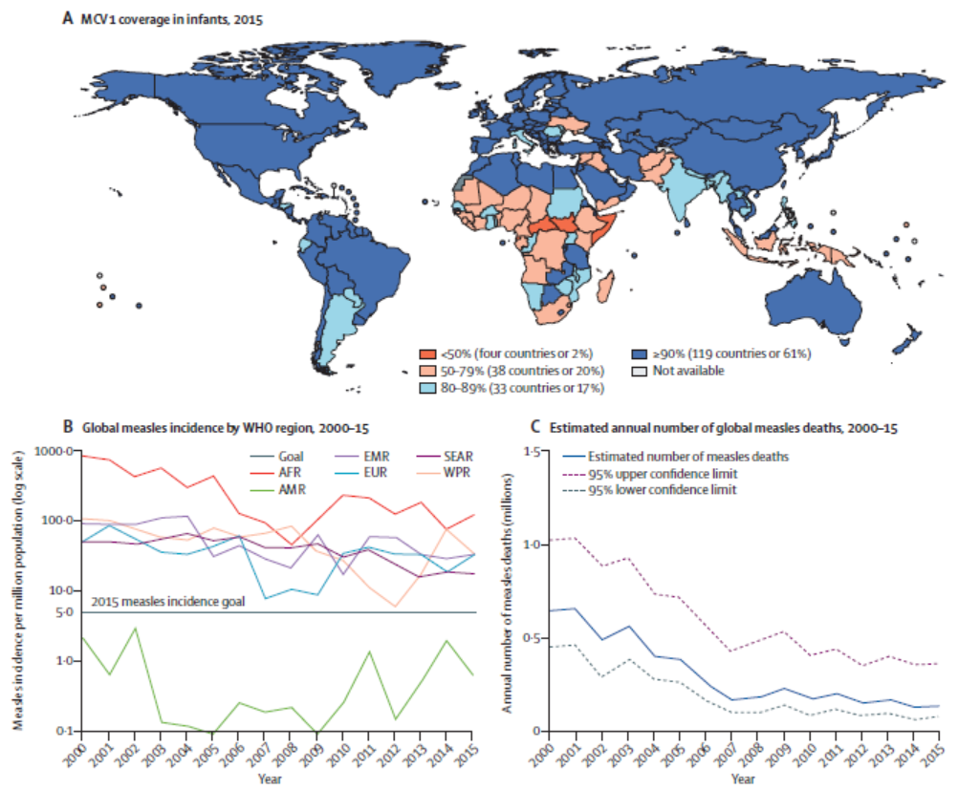
Measles was a leading global cause of child morbidity and mortality before the introduction of measles vaccines in the 1960s,
and is still responsible for more than 100 000 deaths every year, down from more than 2 million deaths annually before the introduction and widespread use of measles vaccine in the 1980s

Slide 6
Measles vaccine coverage has increased from 2000 to 2015
Global annual measles incidence decreased 75% from 2000 to 2015,
but only the Region of the Americas achieved the milestone of less than 5 cases per 1 million population

Slide 7
Pathogen
Measles virus
enveloped, single-stranded, negative-sense RNA virus
six structural proteins
Fragile

Slide 8
Measles virus: types
One serotype
Genotypes
an antigenically monotypic virus
24 genotype reference strains are recognised by WHO
Only 13 of the 24 known genotypes were detected between 2005 and 2014 and only eight since 2009, suggesting that many genotypes are no longer circulating

Slide 9
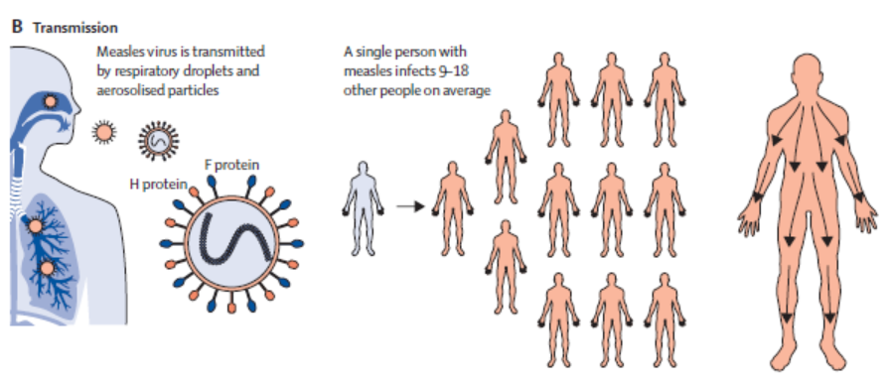
Transmission
Measles is so contagious that if one person has it, 90% of the people close to that person who are not immune will also become infected
only be maintained in human populations, and is not spread by any other animal species
Patients are considered to be contagious from 4 days before to 4 days after the rash appears

Slide 10
Transmission
Measles virus spreads first to local lymphoid tissue and is then disseminated throughout the blood stream through infected lymphocytes, infecting cells in almost all organ systems

Slide 11
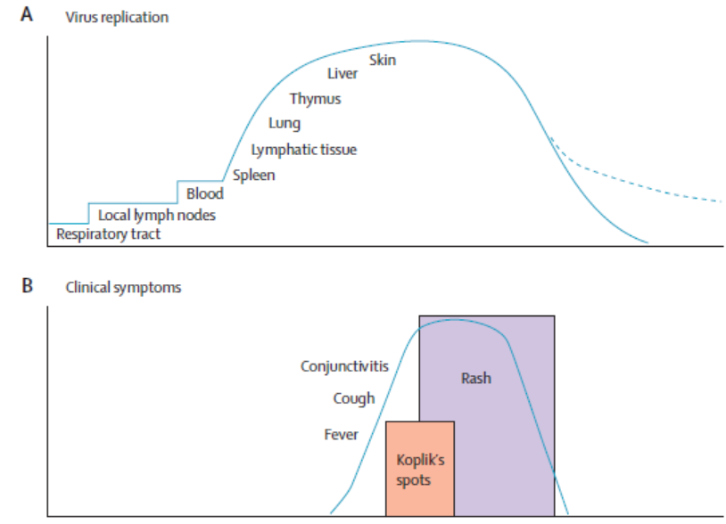
Virus replication
Virus infection starts in the respiratory tract and then spreads to infect multiple organs including lymphoid tissue, liver, lungs, and skin.
Virus clearance begins with the onset of rash
Clearance of infectious virus is complete 20 days after infection but viral RNA persists at multiple sites.
Clinical signs and symptoms begin about 10 days after infection with prodromal symptoms of fever, conjunctivitis and appearance of Koplik’s spots followed by the maculopapular rash that lasts 3–5 days
Lancet 2012

Slide 12
Incubation periods
The incubation period for measles is 12·5 days on average, with a range up to 23 days

Slide 13
Typical measles
Fever
3Cs (cough, coryza, conjunctivitis)
Koplik’s spot
Two or three days after symptoms begin, tiny white spots may appear inside the mouth

Slide 14
Henry Koplik
American pediatrician
Small, grain-of-sand sized, irregular, bright red spots with blue-white centers, occurring on the inside of the buccal mucosa
appear 1~2d before the rash, and are no longer evident 2d into the rash
1890s

Slide 15
Maculopapules
Maculopapules rash of mealses
Three to five days after symptoms begin, a rash breaks out

Slide 16
Maculopapules
Start
End
Disappear
Colors changes
The left side of the drawing shows the early rash covering the head and upper part of the trunk, the right side shows the later rash covering the whole body

Slide 17
Maculopapules
Three to five days after symptoms begin, a rash breaks out. It usually begins as flat red spots that appear first on the face and behind the ears at the hairline and spread downward to the neck, trunk, arms, legs, and feet
Begins as individual red macules that blanch with pressure, then progress to coalescing papules
By the fourth day of the rash, the entire body is typically involved, although the hands and feet may be spared
The rash fades in the same head-to-toe order in which it appeared and often peels with a brawny desquamation during the subsequent weeks

Slide 18
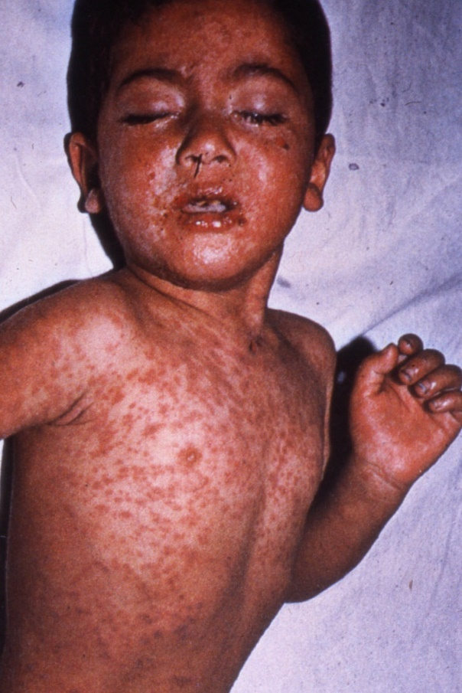
Maculopapules
Merged rashes
The spots may become joined together as they spread from the head to the rest of the body.
When the rash appears, a person’s fever may spike to more than 40 ℃. The fever and catarrhal symptoms typically peak with the rash, which persists for 3–4 days. After a few days, the fever subsides and the rash fades.
The rash might be minimal in children with vaccine-modified measles who have previous immunity following vaccination, and these children might not have cough, coryza, or conjunctivitis.
Malnourished children can develop a deeply pigmented rash that desquamates during recovery.

Slide 19
Complications
Complications of measles can affect most organ systems and are most common in young infants, adults older than 20 years, pregnant women, and those who are immunocompromised or undernourished, particularly children with vitamin A deficiency
Pneumonia, Nasopharyngitis
Keratoconjunctivitis
Diarrhea
Myocarditis
Liver dysfunctions
Aseptic encephalitis
Subacute sclerosing panencephalitis (SSPE)

Slide 20
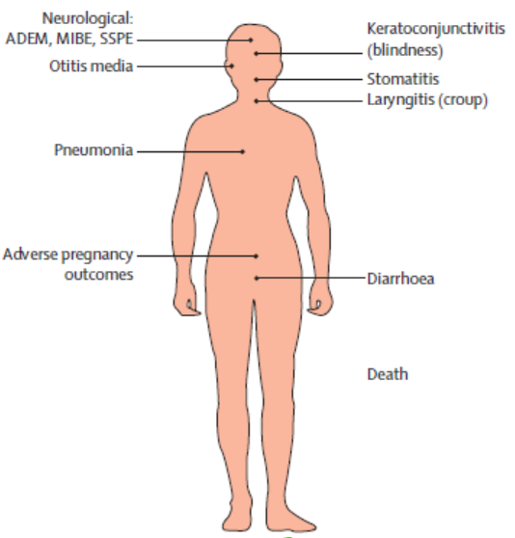
Complications
Pneumonia
The respiratory tract is a frequent site of complication, with pneumonia accounting for most measles-associated morbidity and mortality
Pneumonia is most often caused by secondary viral or bacterial pathogens but can be due to measles virus itself resulting in Hecht’s giant cell pneumonia

Slide 21
Complications
Diarrhea
result in considerable morbidity and mortality,
and is often due to secondary infections with bacteria or protozoa

Slide 22
Complications
Keratoconjunctivitis
another serious complication of measles,
was a frequent cause of blindness before the widespread use of measles vaccine and vitamin A supplementation

Slide 23
Complications
Subacute sclerosing panencephalitis (SSPE)
a delayed complication of measles that occurs in about 1:10 000 to 1:100 000 cases
5–10 years after the acute illness,
caused by the host response to production of mutated virions with defective assembly and budding.
Measles vaccination reduces the incidence of SSPE

Slide 24
Immune suppression
Measles was the first immunosuppressive infection to be described. Deficiencies of both innate and adaptive immune responses can render individuals with measles more susceptible to secondary bacterial and viral infections

Slide 25
Immune suppression
N Engl J Med. 2001

Slide 26
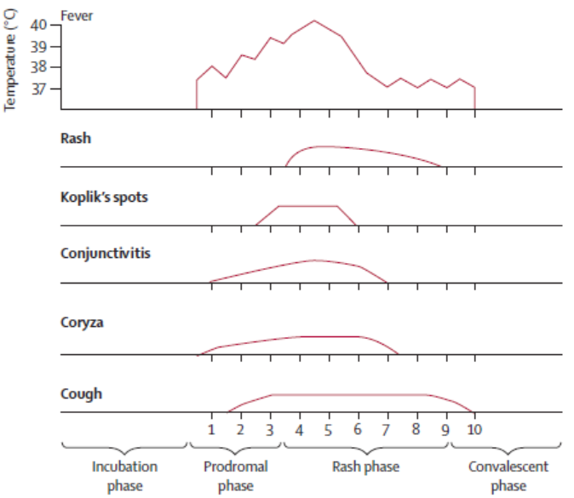
Summary for typical cases
Disease course
Koplik spots appear 1~2d before the rash, and are no longer evident 2d into the rash
The rash appears 3~4d after the onset of fever
The fever and catarrhal symptoms typically peak with the rash
Recovery typically occurs within 1 week of rash onset in people with uncomplicated measles
Lancet. 2017

Slide 27
Atypical measles
incompletely vaccinated
incubation period : 7 - 14 days
high fever with headache
abdominal pain
pneumonia
Rash development: distal to centripetal

Slide 28
Lab findings
Multinucleate giant cells
Measles-specific IgM
Virus isolation

Slide 29
Differential diagnosis

Slide 30
Differential diagnosis

Slide 31
Diagnosis
Clinical findings are adequate
Laboratory findings help little (atypical/differentiation)
The most common laboratory method for confirming measles virus infection is detection of measles virus specific IgM antibodies in serum or plasma
Acute infection also can be confirmed serologically by measuring a four-fold or greater increase in measles virus-specific IgG antibody levels between acute and convalescent sera
also can be confirmed by detection of viral RNA through RT-PCR using throat, nasal, nasopharyngeal, and urine samples before measles virus-specific IgM antibodies are detectable
Point-of-care diagnostic tests that detect measles virus-specific IgM and IgG antibodies in blood and oral fluid have been developed and validated, but are not yet widely available

Slide 32
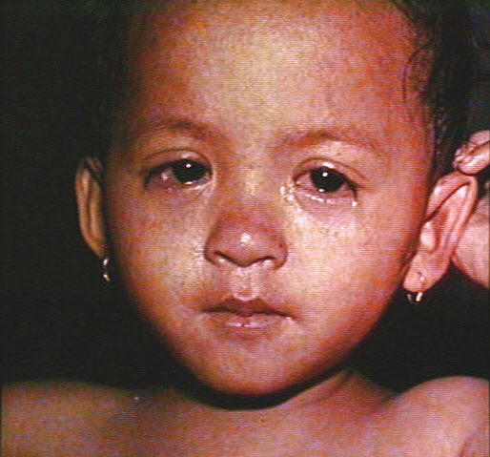
Managements: non-severe cases
Treat as an outpatient
Vitamin A therapy
Nutritional support
Eye care
Mouth care
Fever. If =>39ºC
Antipyretics and analgesics and encouraging fluids to maintain hydration
No specific antiviral therapy is recommended for measles

Slide 33
Severe cases-complications
In hospital
Vitamin A therapy
Supportive care (fever, nutrition support)
Complications (pneumonia, myocarditis, neurological complications, et al.)

Slide 34
Mortality of severe cases
Measles case fatality ratios range from less than one in 1000 cases to 5% in endemic areas in sub-Saharan Africa and Asia, to as high as 20–30% in refugees and internally displaced populations
This variation is determined by the average age of infection, nutritional and immunological status of the population, measles vaccine coverage, and access to health care

Slide 35
Vaccine
1963 (Merck)
John Enders and colleagues transformed their Edmonston-B strain of measles virus into a vaccine and licensed it in the United States
Maurice Hilleman
Further attenuates measles vaccine in 1968
MMR (1971, Merck)
Measles vaccine is usually combined with mumps and rubella (MMR), or combined with mumps, rubella and varicella (MMRV)

Slide 36
Vaccine
After the introduction and widespread use of measles vaccine, the cases have dropped dramatically

Slide 37
Vaccination procedure
9-12 months: 1st shot
4-5 years: 2nd shot

Slide 38
Antibody duration
Antiviral antibody responses were remarkably stable, with half-lives longer than 200 years for viruses such as measles and mumps
NEJM, 2007

Slide 39
Summary for measles
Viral disease
Clinical findings
Fever
3Cs
Koplik’s spots
Maculopapules
Vaccines preventable

Slide 40
Mumps
Overview
History
Pathogen
Case definition
Complications
Lab findings
Preventions

Slide 41
Mumps Overview
Viral diseases
Clinical definitions
Parotitis/swelling salivary glands
Fever
Headache
Orchitis
Vaccine preventable

Slide 42
History
Parotitis and Orchitis described by Hippocrates in 5th century B.C.
Viral etiology described by Johnson and Goodpasture in 1934

Slide 43
Virus causes Mumps

Slide 44
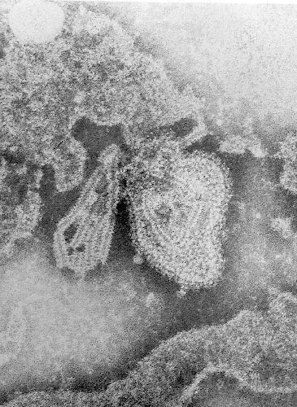
Pathogen
Paramyxovirus
RNA virus
One antigenic type
Rapidly inactivated by chemical agents, heat and ultraviolet light
enveloped, single stranded

Slide 45
Viraemias
Air transmission
Primary viraemia
Secondary viraemia
Most natural infections result from droplet spread of upper respiratory secretions
Primary viral replication takes place in epithelial cells of the upper respiratory tract,
Followed by spread of virus to regional lymph nodes and subsequent viraemia

Slide 46
Epidemics
While reports of mumps cases have declined by more than 90% since the pre-vaccine era, mumps outbreaks still occur in the U.S. and worldwide

Slide 47
Clinical findings
Incubation period 12 - 25 days
Nonspecific prodrome of low-grade fever, headache, anorexia, malaise, myalgias,
Symptoms typically appear 16-18 days after infection, but this period can range from 12-25 days after infection
As many as 40-50% of the infected population have only nonspecific symptoms

Slide 48
Typical clinical findings
Up to 20% of infections asymptomatic
Parotitis
Parotid swelling is present in 95% of symptomatic cases and is bilateral in 90%
Local tenderness, and occasionally earache, precedes parotid swelling
Normally the parotids are not readily discernible → swollen once clinically apparent
The parotitis is due to direct infection of ductal epithelium and local inflammation and may be accompanied by a rise in serum amylase
The orifice of the glandular duct (Stensen’s duct) may become red and oedematous
Clinical symptoms are usually more severe in adults and adolescents than children

Slide 49
Clinical finings
Salivary glands swelling
Orchitis

Slide 50
Maternal mumps infection
Unlike measles, pregnancy does not appear to affect mumps’ severity,
but if exposure occurs during the first trimester, the patient has a higher risk of spontaneous abortion
Spontaneous abortion has been found to occur in 27% of pregnant women exposed to mumps during their first trimester compared to 13% of controls
There are no associated congenital malformations in children whose mothers were exposed to mumps at any time during pregnancy

Slide 51
Complications
Complications of mumps can be serious and include the following
Orchitis (usually unilateral) in 20% of postpubertal young men
Oophoritis in 5% of postpubertal young women
Aseptic meningitis in 15%
Encephalitis in 1 in 6000
Permanent unilateral deafness in 1 in 15 000
Pancreatitis in up to 5%
Arthritis, thyroiditis, myocarditis, and, very rarely, hepatitis
Increased risk of miscarriage in the first 12 weeks of pregnancy

Slide 52
Differential diagnosis
Bacterial Parotitis
presents as a unilateral swelling, where the gland is swollen and tender and usually produces pus at the Stensen's duct

Slide 53
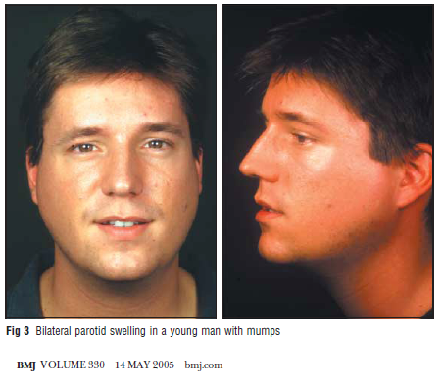
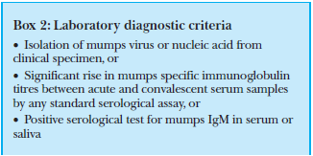
Diagnosis

Slide 54
Treatments
No specific therapy
Rests
intermittent ice or heat
Warm salt water gargles, soft foods
Painkillers
avoid fruit juice or any acidic foods

Slide 55
Mumps Epidemiology
Reservoir Human
Transmission Respiratory drop nuclei
Subclinical infections may transmit
Temporal pattern Peak in late winter and spring
Communicability Three days before to four
days after onset of active
disease

Slide 56
No quarantine

Slide 57
Vaccines preventable

Slide 58
Vaccine
Hilleman MR
1963 (Jeryl Lynn strain)
MMR (1971, Merck)
Measles vaccine is usually combined with mumps and rubella (MMR), or combined with mumps, rubella and varicella (MMRV)

Slide 59
Vaccination procedure
9-12 months: 1st shot
4-5 years: 2nd shot

Slide 60
Antibody duration
Antiviral antibody responses were remarkably stable, with half-lives longer than 200 years for viruses such as measles and mumps
NEJM, 2007

Slide 61
Mumps summary
Viral disease
Typical clinical presentations
Swelling of salivary gland(s)
Complications (other glands, neurological signs )
IgM antibody
Non specific therapy
Vaccine preventable

Slide 62
More references
https://www.cdc.gov/
http://www.who.int/
Lancet 2017; 390: 2490–502. http://dx.doi.org/10.1016/S0140-6736(17)31463-0
Clin Obstet Gynecol. 2012 Jun;55(2):550-9. doi: 10.1097/GRF.0b013e31824df256
BMJ. 2005 May 14;330(7500):1132-5

Slide 63
THANK YOU FOR YOUR ATTENTIONS

